Slide 1
We are called to be saints!
“You shall be holy; for I the Lord your God am holy.” (Lev 19:2)
“Young people of every continent, do not be afraid to be the saints of the new millennium! Be contemplative, love prayer; be coherent with your faith and generous in the service of your brothers and sisters, be active members of the Church and builders of peace. To succeed in this demanding project of life, continue to listen to His Word, draw strength from the Sacraments, especially the Eucharist and Penance. The Lord wants you to be intrepid apostles of his Gospel and builders of a new humanity.”
(Saint Pope John Paul II)
“Being saints is not a privilege of the few, but everyone’s vocation.”
“Go, do not be afraid, and serve.”
(Pope Francis)

Slide 2
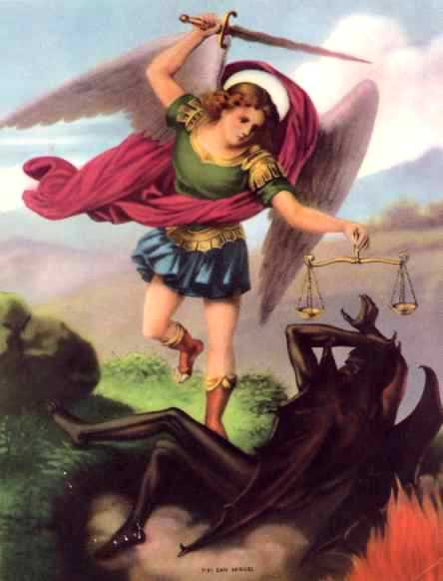
We are all called to the Fullness of Christian Life
Work on our spiritual progress…focus on growing closer to God daily
Participate in the Sacraments for strength
Form a GOOD conscience…moral character
Pray!

Slide 3
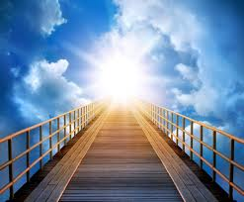
The Perfection of Charity
“Be perfect as your heavenly Father is Perfect.” (Mt. 5:48)
Be open to the Holy Spirit…
Devote yourself to the SERVICE of others
Ask for GRACE…helps you to LOVE
Remember: we are on a journey to Heaven

Slide 4
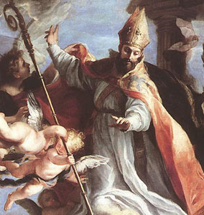
St. Augustine:
"You have made us for yourself, O Lord…
…and our heart is restless until it rests in you.”

Slide 6
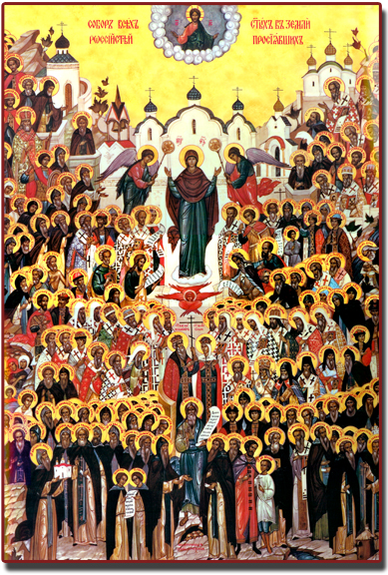
A Little Help Here? Saints!Saints!Saints!
“The saints have always been the source of renewal in the most difficult moments in the Church’s history.”
(CCC 828)
Being more closely united to Christ, those who dwell in heaven fix the whole Church more firmly in holiness
Intercession

Slide 7
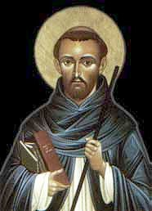
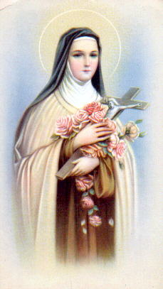
“Do not weep, for I shall be more useful to you after my death and I shall help you then more effectively than during my life.”
–St. Dominic
“I want to spend my heaven doing good on earth.”
- St. Therese of Lisieux

Slide 8
Hebrews 12:1-13 :
Therefore, since we are surrounded by so great a cloud of witnesses, let us rid ourselves of every burden and sin that clings to us and persevere in running the race that lies before us while keeping our eyes fixed on Jesus, the leader and perfecter of faith. For the sake of the joy that lay before him he endured the cross, despising its shame, and has taken his seat at the right of the throne of God.

Slide 9
The Saint That is Just Me
When you hung upon the cross looking at me, You didnʼt die so I would try to be somebody else. You died so I could be the saint that is just me.
-Danielle Rose
How will YOU be a saint???

Slide 10
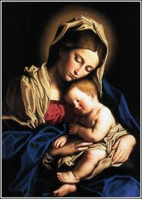
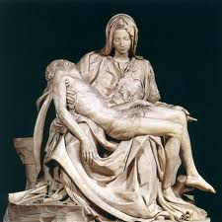
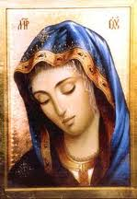
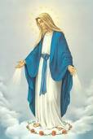
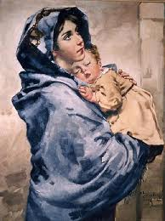
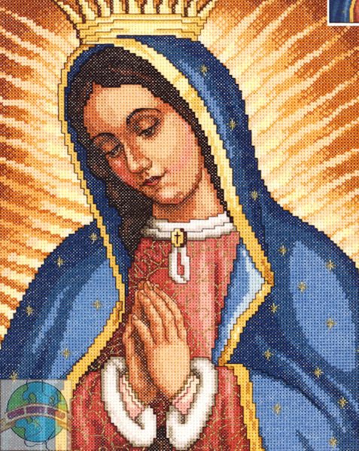
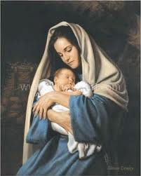
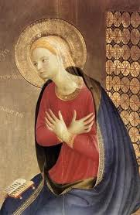
Mary,Mother of God

Slide 11
Mother of Christ…Mother of the church
Fiat → Theotokos
Her role is inseparable from her union with Christ & flows from it.
Given as mother to all

Slide 12
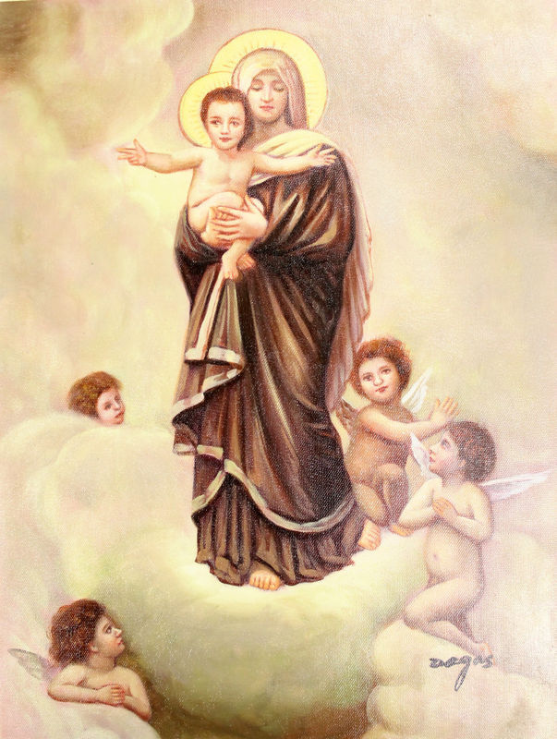
Assumption of Mary
Was taken up body & soul into heavenly glory
Exalted by the Lord as Queen over all things
Shows participation in Jesus’ Resurrection and anticipates our resurrection

Slide 13
Mother in the order of GRACE
Why Pray to Mary?
Model of faith and charity
Complete adherence to the Father’s will
Cooperated by obedience, faith, hope, and charity with Jesus to restore our souls

Slide 14
Titles of Mary

