Slide 1
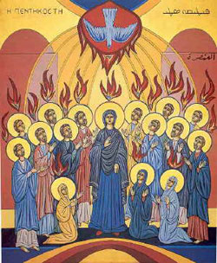
Pentecost:
The Birthday of the Church

Slide 2
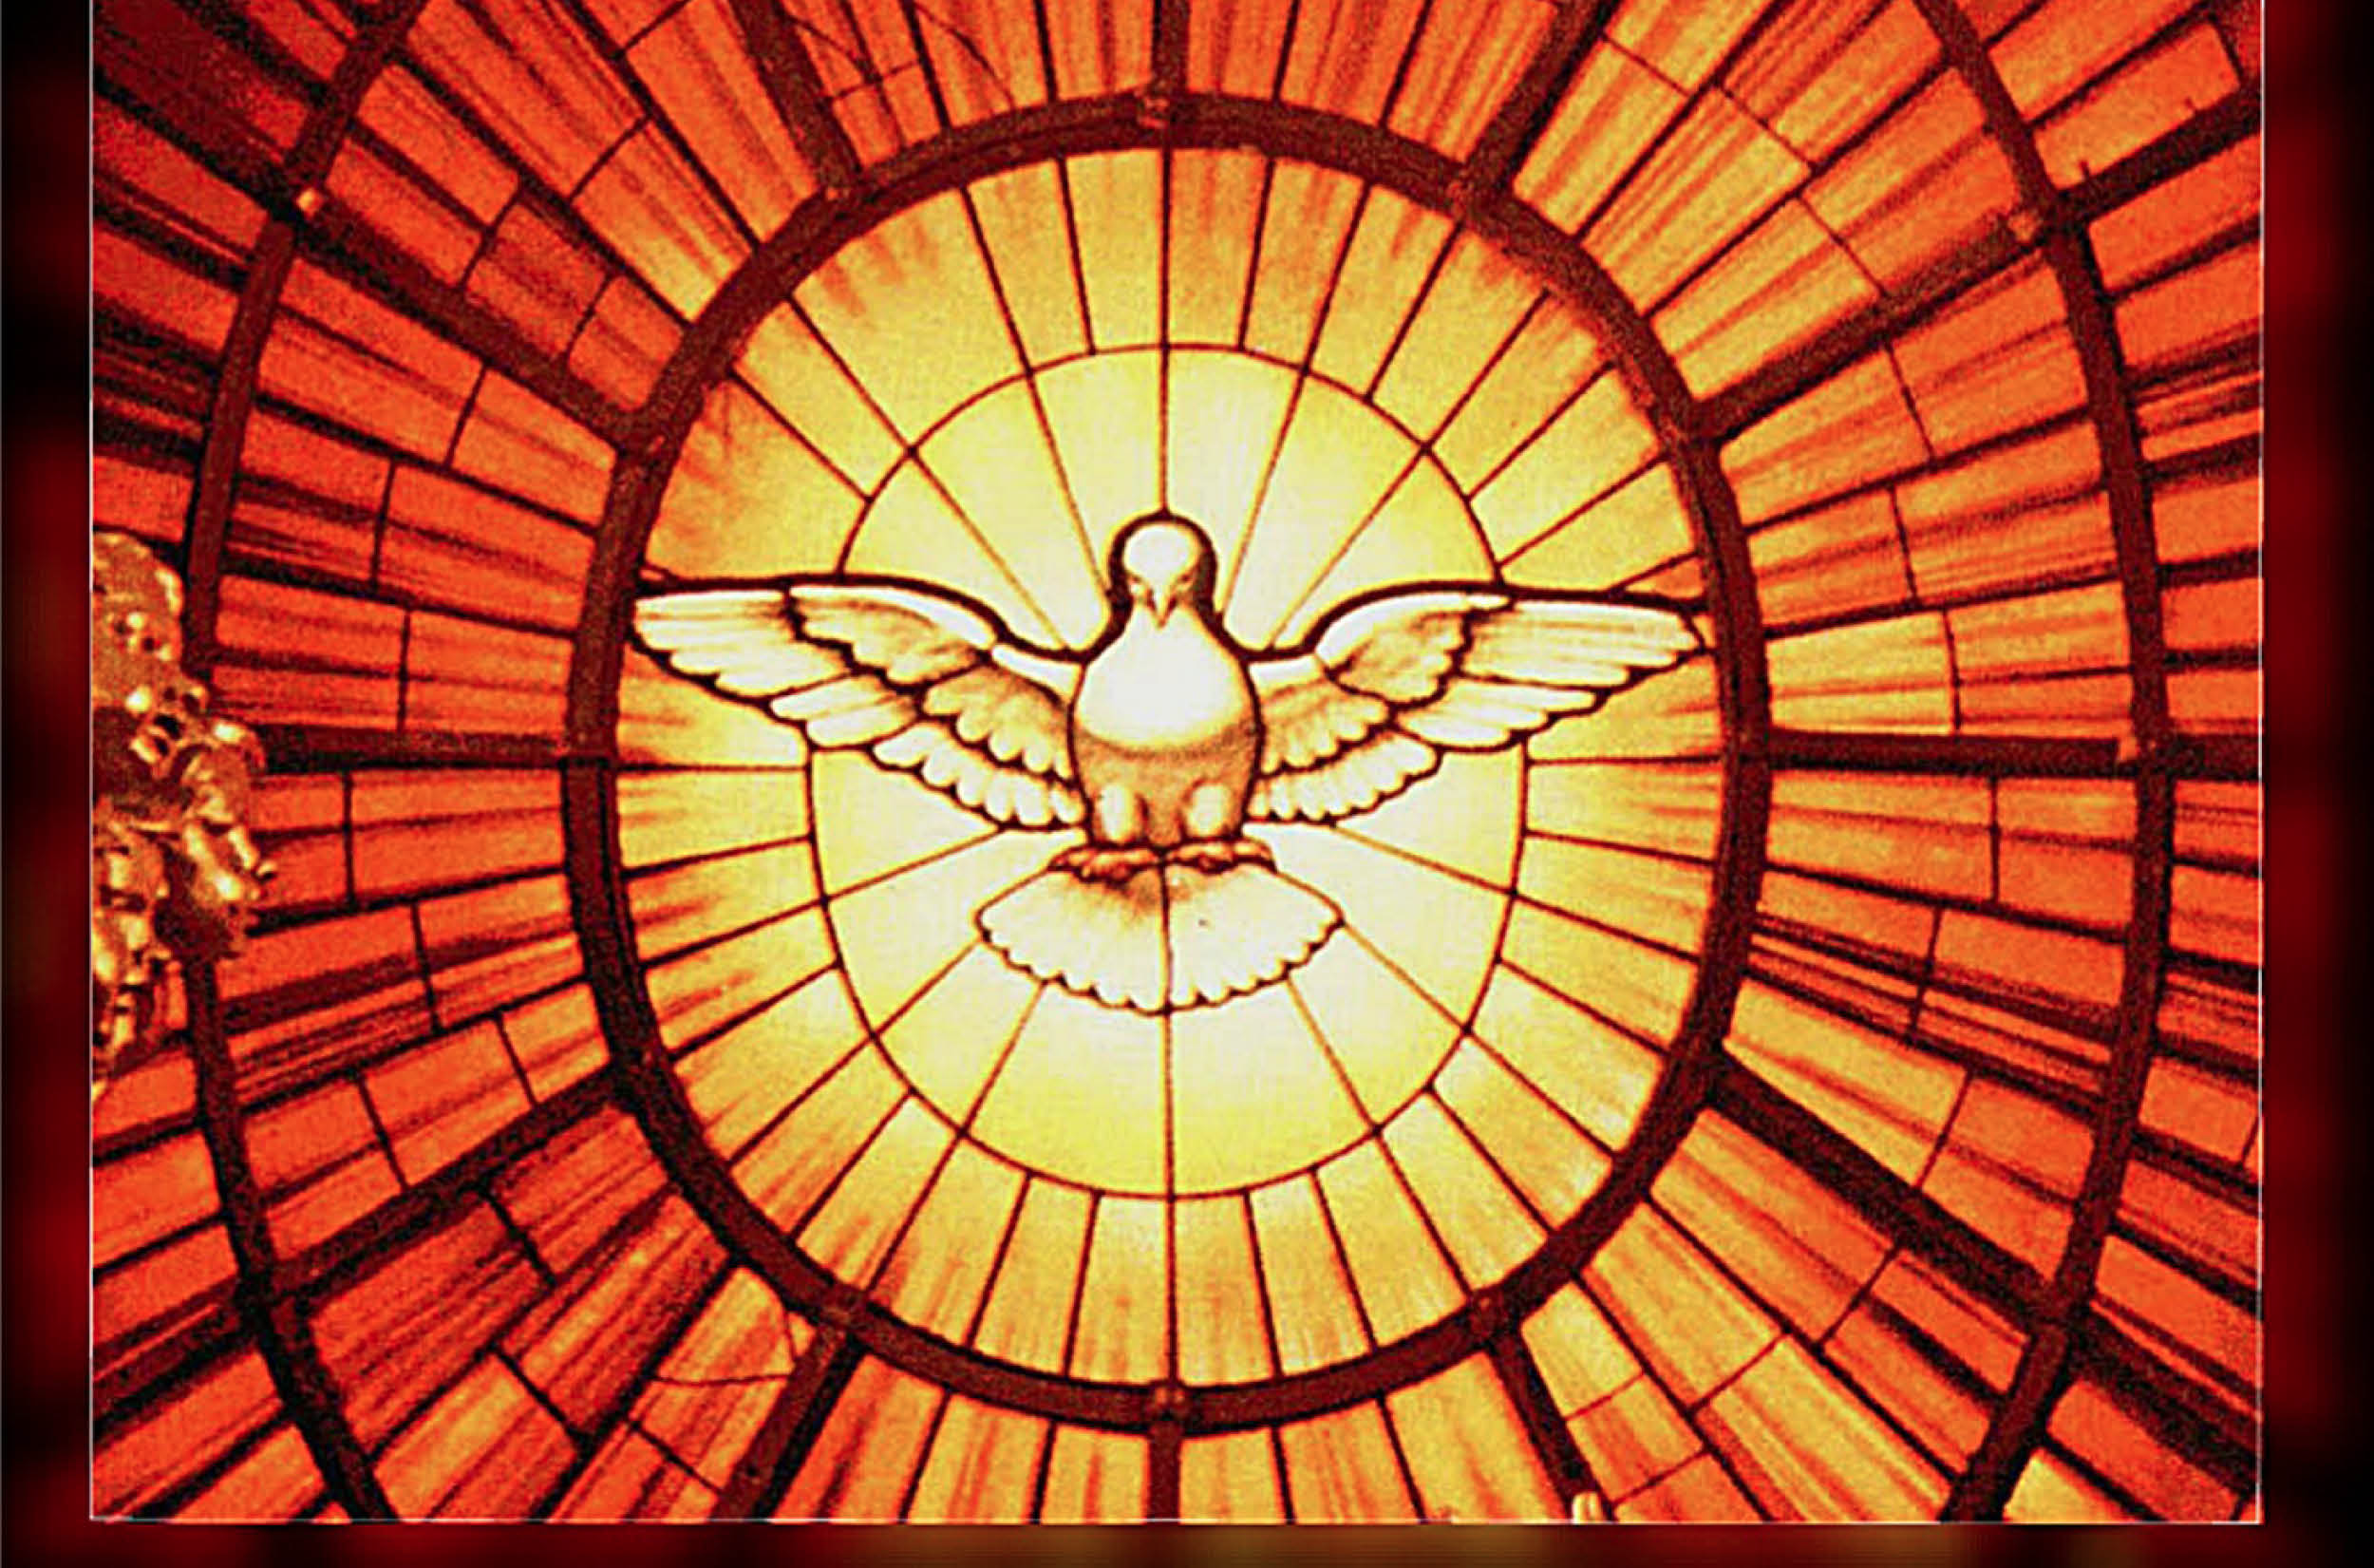
“Come, Holy Spirit”
Acts 2: 1-41

Slide 3
Reflect:
Acts 2: 12: “What does this mean?”
If you were one of those gathered who witnessed the descent of the Holy Spirit, how would you explain it?
What might be the significance of Jews from many nations being able to understand the Word of God proclaimed in their native languages? What significance does this have for us today?
The outpouring of the Holy Spirit is meant to help, encourage, and strengthen us as a Church community and in our own lives. In what ways do you see the power of the Holy Spirit alive and active in our Church, school community, society, and world?

Slide 4
Let us pray:
Come Holy Spirit, fill the hearts of your faithful and kindle in them the fire of your love. Send forth your Spirit and they shall be created. And You shall renew the face of the earth. O, God, who by the light of the Holy Spirit, did instruct the hearts of the faithful, grant that by the same Holy Spirit we may be truly wise and ever enjoy His consolations, Through Christ Our Lord, Amen.

Slide 5
Articles 30-31
Saved from…Saved for…

Slide 6
YOU WERE SAVED FOR A PURPOSE
“Therefore do not be ashamed of the testimony of our Lord or of me His prisoner, but join with me in suffering for the Gospel according to the power of God, who has saved us and called us with a holy calling, not according to our works, but according to His own purpose and grace which was granted us in Christ Jesus from all eternity, but now has been revealed by the appearing of our Savior Christ Jesus, who abolished death and brought life and immortality to light through the Gospel.” --2 Timothy 1: 8-10

Slide 7
Saved from… Sin and Its Consequences:
Guilt and shame
Loneliness, despair, and the feeling of being unloved
Addictions and attachments to things
Death
Litany of Humility

Slide 8
Saved for… Eternal Life!
Forgiveness and healing
Freedom
Joy
Loving communion
Beatific vision
Eternal life!

Slide 9
But… my life’s not perfect…
Even though Christ has saved us, obstacles remain:
Weakness of will
Illness/ frailty
Temptation
Concupiscence
We are “in-between”—citizens of the Kingdom of God not yet in a state of perfect grace

Slide 10
We are given GRACE:
The free and undeserved gift of God’s loving and acting presence in our lives, empowering us to respond to his call and to live as his adopted sons and daughters.
Grace enables us to:
Practice the virtues (Faith, Hope, Love, Prudence, Justice, Temperance, Fortitude)
Follow the Spirit in our lives
Grow in holiness
The Sacraments aid us on our journey

Slide 11
Be God’s
LET YOUR LIFE CHANGE THE WORLD ONE PERSON AT A TIME. LET YOUR LIFE BE THE PRESENCE OF OUR LORD JESUS CHRIST AS THE BREAD BECOMES HIS BODY, WE CAN BE A LIVING SIGN WITH GOD'S LOVE,
CHANGE THE WORLD WITH YOUR LIFE.

Slide 12
Our Call to Holiness
Article 34

Slide 13
What is holiness?
The state of being holy
To be set apart for God’s service
To live a morally good life
To be a person of prayer
To reveal God’s love to the world through acts of loving service

Slide 14
3 Dimensions of “Holy” People
Reveal God and share in God’s own life
Consecrated/ set aside for service to God
Clean/ pure

Slide 15
Aids to Holiness
“Be perfect, just as your heavenly Father is perfect.” (Mt. 5: 48)
“The way of perfection passes by the way of the Cross. There is no holiness without renunciation and spiritual battle.” (CCC 2015)
Help!
Intellect and free will
Interiority/ self-reflection
Grace
The Sacraments
The Church

Slide 16
Participating in Christ’s Ministry
Articles 35-37

Slide 17
“Anointed” Titles
Priest, Prophet, King
“Jesus Christ is the one whom the Father anointed with the Holy Spirit and established as priest, prophet, and king. The whole People of God participates in these three offices of Christ and bears the responsibilities for the mission and service that flow from them.” (CCC 783)
Even includes the laity

Slide 18
Priest
What is the meaning of this role?
Lead worship, teach Scripture, offer sacrifices
How did Jesus fulfill this in his ministry?
Perfectly fulfilled the sacrificial role
Taught us how to pray
Explained/ fulfilled Scriptural prophecies
How do we participate in this ministry?
Pray, attend Mass, make sacrifices for the good of others

Slide 19
Prophet
What is the meaning of this role?
To give voice to God’s Word; lead people to God
How did Jesus fulfill this in his ministry?
All of Jesus’ words and actions are prophetic
See many parallels with OT prophets (pg. 161)
How do we participate in this ministry?
Speak up for the poor and vulnerable
Help people in need (volunteer! serve!)
Share the faith (be a catechist)

Slide 20
King
What is the meaning of this role?
Lead—choose to do good
How did Jesus fulfill this in his ministry?
“My kingdom is not of this world.” (John 18: 36)
Obedience to God’s will, service to all (especially the “least”)
How do we participate in this ministry?
Be pure, be humble, put others first

Slide 21
Article 32
Our Judgment by God

Slide 22
We will each face two times of judgment:
Particular Judgment
Final Judgment
Parousia
God’s Kingdom come: “a new heaven and a new earth” (Rev. 21: 1)

Slide 23
When will Christ return?
“But about that day and hour no one knows, neither the angels of heaven, nor the Son, but only the Father.” (Matt. 24: 36)
Do not be afraid—Trust Jesus—Be watchful

Slide 24
Article 33
Heaven, Hell, and Purgatory

Slide 25
Sin
Venial sin
An offense against the will of God that diminishes one’s personal character and weakens but does not rupture one’s relationship with God.
Mortal sin
An action so contrary to the will of God that it results in complete separation from God and his grace.
3 Conditions:
Grave Matter
Full Knowledge
Full Consent

Slide 26
Heaven
A state of eternal life and union with God in which one experiences full happiness and the satisfaction of the deepest human longings.

Slide 27
Hell
The eternal punishment of separation from God, reserved for those who die in mortal sin and are unrepentant, thus freely and consciously rejecting God at the end of their lives.

Slide 28
Purgatory
A state of final purification or cleansing, which one may need to enter following death and before entering Heaven.
Those who die in God’s grace and friendship, but not perfectly purified (having venial sin)

Slide 29
Suffering
Articles 38-40

Slide 30
The Mystery:
“I know that you can do all things, and that no purpose of yours is hindered. I have dealt with great things that I do not understand; things too wonderful for me, which I cannot know.” (Job 42:2-3)
We can never fully understand suffering because we do not see things from God’s perspective

Slide 31
We do know…
Suffering was not a part of God’s original plan for us
Suffering entered the world as a result of Original Sin
Jesus made our suffering his own by assuming a human nature
Sacrifice is the pathway to salvation
Sacrifice is simply suffering that is freely accepted
God transforms suffering and sacrifice into healing and new life!
When can/do you make sacrifices as a disciple?

Slide 32
Accepting Suffering
The willingness to accept suffering takes courage and strength (Fortitude)
We must sacrifice for the right reasons
Build up God’s Kingdom, not your own
Keys to Hope and Strength
Remember God is with us
Help one another
Look beyond

