Slide 1
Article 1
Primeval History

Slide 2
Creation Stories
Reveal important truths about God
World created out of God’s love and goodness
God is truth, devil is falsehood
Primeval history, not archaeological records

Slide 3
Primeval History
Religious truth, not science
Figurative language
Genesis 2:21: So the Lord God caused a deep sleep to fall upon the man, and he slept; then He took one of his ribs and closed up the flesh at that place.
Can religious truth and scientific facts contradict each other?
“Reason and faith cannot be separated without diminishing the capacity of men and women to know themselves, the world and God in an appropriate way.” – Pope John Paul II

Slide 4
Article 2
Creation Reflects the Glory of God

Slide 5
Creation
Is the work of the Trinity
Genesis 1:26: Let Us make man in Our image, according to Our likeness
Psalm 33:6: By the word of the Lord the heavens were made, And by the breath of His mouth all their host.
John 1:1-3: 1 In the beginning was the Word, and the Word was with God, and the Word was God. ² He was in the beginning with God. ³ All things came into being through Him, and apart from Him nothing came into being that has come into being.
“All things visible and invisible”

Slide 6
Article 3
Human Beings: The Summit of Creation

Slide 7
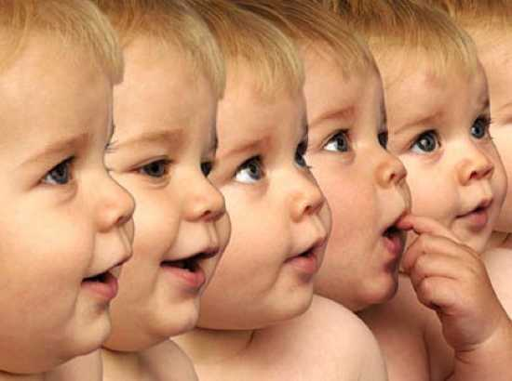
Humans
What distinguishes humanity from the other earthly creatures?
Created in God’s image
Soul
Free will
Intellect/ Consciousness
You are an end in yourself

Slide 8
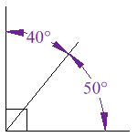
Men & Women
Different, but both made in God’s image & likeness and equal in dignity
Gen 2:18- “It is not good for man to be alone.”
Not solitary creatures
Men and women and mentally and physically complementary
Union of man & woman reflects the perfect union of the Trinity and allows us to share in God’s creative power.

Slide 9
Purpose of Humans
“God made us to know him, to love him, and to serve him in this world, and to be happy with him forever in the next.”
Be in communion with God & respond to his love by loving him in return
Serve him particularly as stewards of creation

Slide 10
Article 4
The Garden of Eden: The Perfect Life

Slide 11
Adam and Eve
Friendship with God
Original Holiness
Original Justice

Slide 12
Article 5
Adam and Eve’s Disobedience

Slide 13
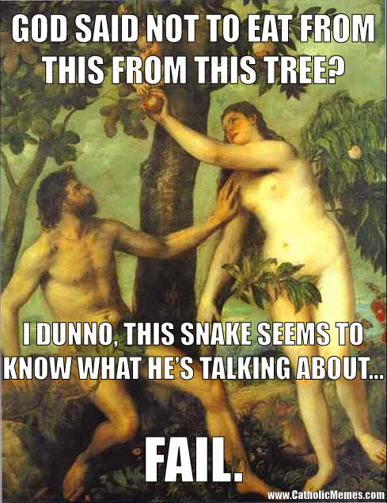
The Fall
Genesis 2:16-17 : The command and the consequence
Temptation
Sin and shame
The blame game
Loss of original holiness & justice ☹

Slide 14
Their Sin
Misuse of human freedom and lack of trust in God
Pride: “We know better than God.”

Slide 15
Article 6
Original Sin: A Consequence of the Fall

Slide 16
Original Sin
Humanity deprived of original holiness and justice
We need a Savior

Slide 17
Results of Original Sin
Concupiscence
Clouded relationship with God
Suffering and death

Slide 18
Article 7
Satan and the Fallen Angels

Slide 19
Fallen Angels
Chose to reject God
Could no longer be in His presence

Slide 20
Satan’s Power is Limited
Tempts our human nature
Not all-powerful

