Slide 1
Unit 2
How does the Incarnation fulfill God’s promise of redemption?

Slide 2
Article 8
God’s Promise to Adam and Eve

Slide 3
God’s Promise to Adam and Eve
Protoevangelium
Video
Literal Sense & Spiritual Sense—see pg. 38 chart
Mary is the new Eve and Christ is the new Adam
“O happy fault, O necessary sin of Adam, which gained for us so great a Redeemer!”

Slide 4
Sin Increases, God Remains Faithful
Cain and Abel
Noah and the Flood
The Tower of Babel

Slide 5
Article 9
The Old Testament Covenants: Part 1

Slide 6
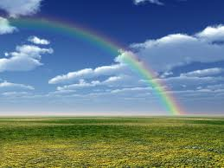
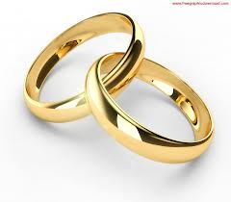
Covenant
A solemn agreement in which mutual commitments are made
NOT a contract
Cannot be changed, nullified, or have set limitations
Total self-giving of the involved parties
May be added to, but not replaced
Usually a visible sign of the agreement

Slide 7
The Covenant with Noah
Universal Nature
Still Inclination to and Danger of:
Polytheism
Idolatry

Slide 8
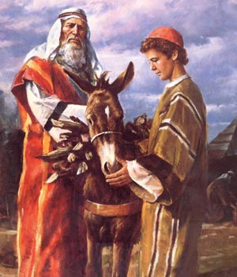
Abrahamic Covenant
Three-fold Promise:
Many descendants
Land of their own
Blessing for all nations
Promise contingent on three conditions
One God
No Sin
Circumcision

Slide 9
Article 10
The Old Testament Covenants: Part Two

Slide 10
Mosaic Covenant
Theophany
Ten Commandments (summary)
Old Law
Torah (GELND)
To be faithful to the Covenant, keep the Law

Slide 11
The Davidic Covenant
King David, through Nathan
Ark of the Covenant
“Your house and your kingdom shall endure forever before me; your throne shall stand firm forever.” (2 Samuel 7:16)
Christ is a direct descendent
Points us toward restoration of Original Holiness and Justice

Slide 12
Article 11
Covenant Keeping: Successes and Failures

Slide 13
The Judges of Israel
The Israelites are settled in Canaan
Confederation: An alliance of tribes with no central authority
Great [military] leaders
Sin and Repentance: The Cycle
God desires commitment

Slide 14
The Monarchy (1 & 2 Samuel, 1& 2 Kings, 1 & 2 Chronicles)
Samuel
Last judge, appoints kings
Saul, David, Solomon
Unity of Tribes→Temple
Israel and Judah (after Solomon)
Covenant reinforced and Christ is foreshadowed

Slide 15
The Prophets
Watchdogs/Spokesmen
Isaiah
Jeremiah
Ezekiel
Daniel
PLUS 12 minor prophets & others
Endured hardship
Faithfulness was essential for salvation
Foreshadows Christ’s role as Prophet

Slide 16
Article 12
The Growing Messianic Hope

Slide 17
Hope
Hope
A virtue
Gift of faith
Prophets helped instill hope
Waiting for the Messiah: “anointed one”
Pg. 54- Prophecies of Hope

Slide 18
Article 13
God Prepares the Way: The Roles of Mary and Joseph

Slide 19
Mary’s Faith and Trust
Annunciation
Gabriel
Fiat
Shows Mary’s faith and trust
Theotokos
All done by God’s grace
Mary fully and freely gives herself over to God’s plans and gives her consent to the Incarnation
Dogma of the Immaculate Conception
Virgin birth a sign of Christ’s divine nature
Christ as the New Adam

Slide 20
Joseph’s Faith and Trust
Exhibits compassion
Visited by an Angel
Trust and unhesitating obedience to God’s call
Model husband and father
Speculated that he died before Christ’s public ministry
Patron of the universal Church, happy death, workers, and fathers

Slide 21
Article 14
The Gospels and Christological Prophecies

Slide 22
Prophecy and Fulfillment
“Then, beginning with Moses and all the prophets, he interpreted to them what referred to him in all the scriptures.” -Luke 24:27
Jesus’ life and mission are foreshadowed in the Old Testament
Christological (having to do with Christ) Prophecies
Pg. 63 Chart

Slide 23
Article 15
Why the Word Became Flesh

Slide 24
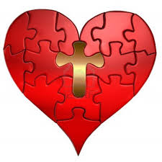
Analogy of Faith
Each doctrine in our faith is connected with Revelation and with all of the other doctrines
Incarnation and Paschal Mystery
Paschal Mystery could not have happened without Incarnation
No need for Incarnation without Paschal Mystery

Slide 25
Reasons for the Incarnation
Expiation for our sins “For just as through the disobedience of one person the many were made sinners, so through the obedience of one the many will be made righteous.” –Romans 5:19
Understand the depth of God’s love for us “For God so loved the world that he gave his only Son, so that everyone who believes in him might not perish but might have eternal life.” –John 3:16
Model of Holiness “This is my beloved Son. Listen to him.”—Mark 9:7 “This is my commandment: love one another as I love you.” –John 15:12

Slide 26
Reasons for the Incarnation
4. Share in the Divine life “He became man so that we might be made God; and he manifested himself in the flesh, so that we might grasp the idea of the unseen Father; and he endured the insolence of men, so that we might receive the inheritance of immorality.” –St. Athanasius (God wants us to become the image of God we were created to be.)
5. Destroy the Devil’s power “Indeed, the Son of God was revealed to destroy the works of the devil.” –1 John 3:8 (Jesus resisted temptation, and his Passion, Death, and Resurrection made him victorious over evil; Satan has no power over us.)

Slide 27
Article 16
The Titles Say It All

Slide 28
Titles of the Messiah
Titles show a person’s role/importance in society
Jesus’ many titles show his central role in salvation history
Jesus- “God Saves”
Christ- Messiah- “Anointed”
Son of God (Fully God and fully human; begotten, not made)
Lord (Greek word for God in place of Hebrew Yahweh)
Alpha & Omega…Bread of Life…Savior…Good Shepherd…King of Kings… Lamb of God… the Way, the Truth, and the Life…Light of the World…

