Slide 1
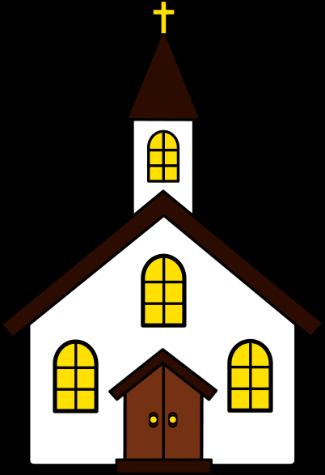
Introduction: Church Models

Slide 2
“What is the Church?”
Cardinal Avery Dulles developed a way of answering this question using models.
*Trivia Question: A busy “transportation station” is named after Cardinal Avery’s father. – Where and what?

Slide 3
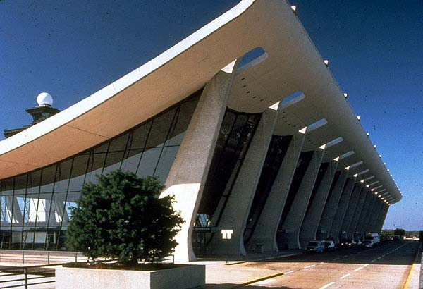
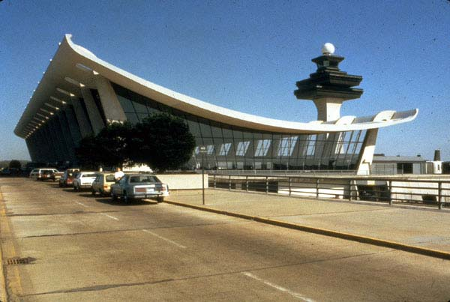
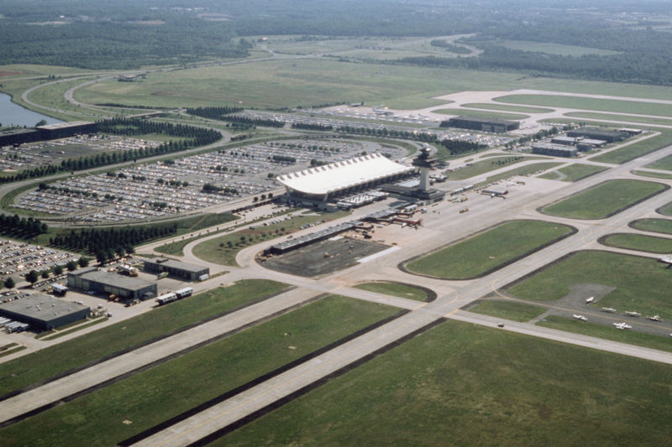
.
ANSWER:
Dulles International Airport
Washington, DC
(Virginia)

Slide 4
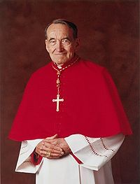
Cardinal Avery Dulles, S.J.
(1918-2008)

Slide 5
Models
Sacrament
Herald
Servant
Institution
Community of Disciples/ Body of Christ
1976, 1987, 2002

Slide 6
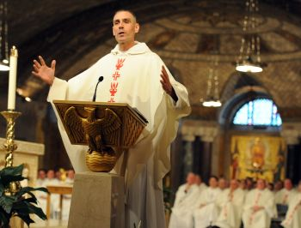
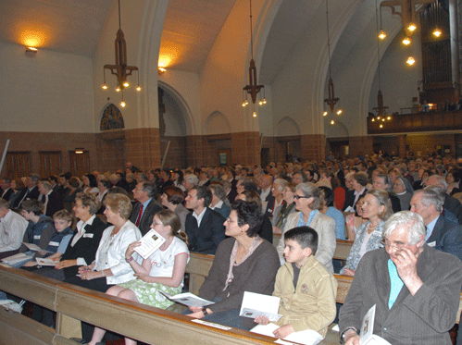
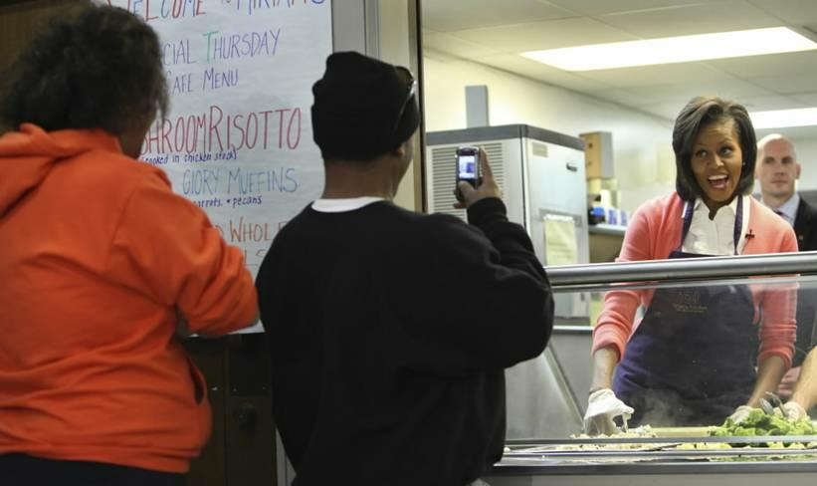
SACRAMENT:
a physical sign of God’s saving love
  How is God’s saving power revealed?
    When the people of the Church worship, preach, and serve

Slide 7
The Church as Sacrament
The Church is seen first and foremost as a visible sign of the presence of Christ in the world.
The Church becomes the visible way Christ works in the world.
“You are the light of the world. A city on a hill cannot be hidden. Neither do people light a lamp and put it under a bowl. Instead they put it on its stand, and it gives light to everyone in the house. -Matthew 5:14-15

Slide 8

The Church as Herald
The Church is the primary messenger of the Gospel. The Church is the voice, the announcer of the Kingdom of God.
Jesus came to proclaim the Good News, the first Christians continued this mission, and the members of the Church today are still called to be the heralds of the Church.

Slide 9
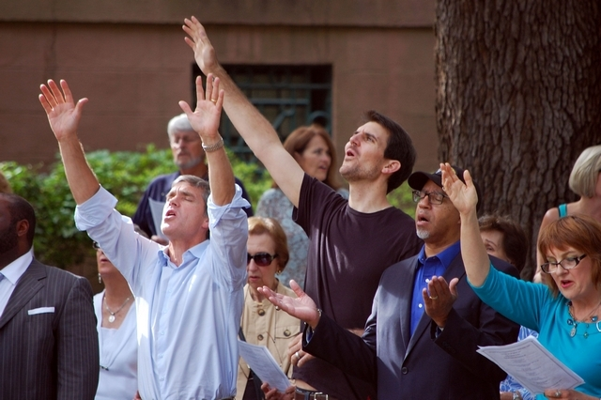
HERALD
Why spread the Good News?
Belief in Jesus Christ and his Gospel comes about through hearing the word of God preached by credible witnesses to the Gospel.
  Jesus said:
  “Where two or three are gathered in my name, I am there among them.” (Mt. 18:20)

Slide 10
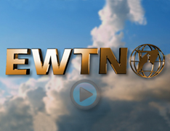
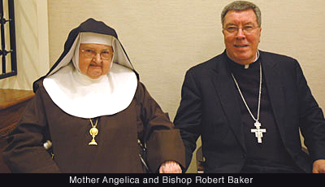

HERALD Examples
Liturgy of the Word at Mass
Church publications
TV programs
Radio Programs
Missionaries
Loving, committed actions of Christians

Slide 11
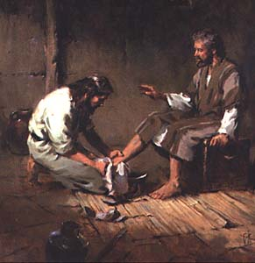
SERVANT:
One who gives of themselves by making sacrifices for others
Who modeled servanthood best? (Hint: Isaiah 53)
Jesus, the “Teacher and Lord,” washes the feet of his disciples. (John 13: 1-17)

Slide 12
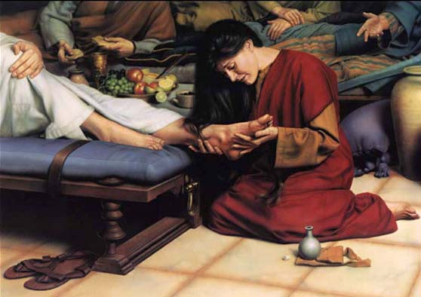
SERVANT:
Who are we really serving when we serve with compassion?
  “I was hungry and you gave me food, I was thirsty and you gave me something to drink, I was a stranger and you welcomed me, I was naked and you gave me clothing, I was sick and you took care of me, I was in prison and you visited me” (Mt 25:35).
We are at the service of God & therefore of all humankind.

Slide 13
The Church as Servant
The strength of this model is that the Church is filled with believers who authentically live their faith. Believers work for a better world where all receive the things they need.
The weakness is that there can be such an emphasis on action that a faith dimension is lost. The community can simply be a collection of activists with no distinctive belief in God or Jesus.

Slide 14

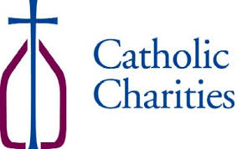
SERVANT Examples
The Church is called to be a servant to the world, to offer herself out of love for God.
She has created many service organizations:
  Education
  Hospitals & clinics
  Orphanages
  Soup kitchens
  Retirement homes
Notes:
STOP HERE BEFORE INSTITUTION

Slide 15
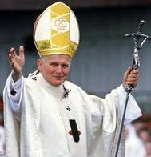
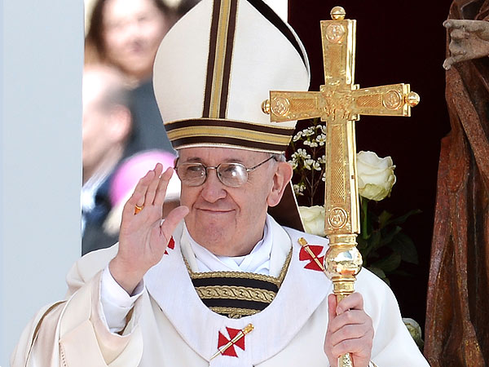
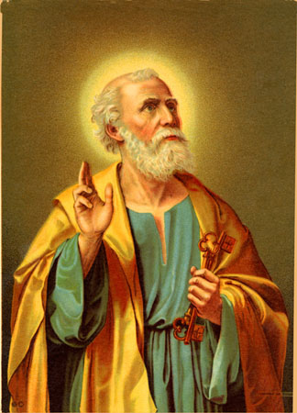
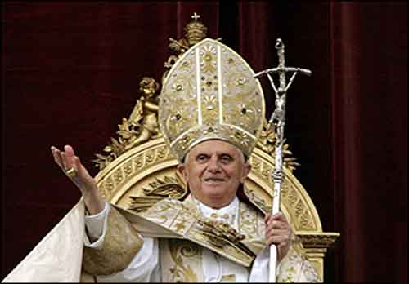
INSTITUTION
Perhaps the most familiar model of the Church to us: WHY?
  We connect with the visible hierarchy: the pope, bishops, and priests
    The Church as Institution refers to: the hierarchical structure and order of the Church

Slide 16
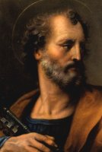
Petros: (Cephas) means Rock
Jesus says to Peter:
  “You are ‘Rock’, and on this rock I will build my Church and the gates of hell will not prevail against it. I will give you the keys to the kingdom of heaven. Whatever you bind on earth shall be bound in heaven; and whatever you loose on earth shall be loosed in heaven.” (Matt. 16: 18-19)

Slide 17
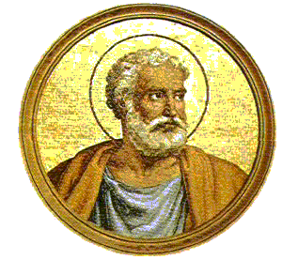
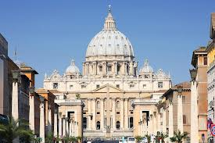
St. Peter: The First Pope
The early Christians, who were close to the Apostles in time, culture, and theological background, clearly understood that Jesus gave this leadership role to Peter.

Slide 18
A developing institution is seen from the beginning of the Church:
Jesus commissioned the Apostles to preach the Good News: Mt 28: 19-20:
Go, therefore, and make disciples of all nations, baptizing them in the name of the Father, and of the Son, and of the holy Spirit, teaching them to observe all that I have commanded you. And behold, I am with you always, until the end of the age.”
The Apostles in turn commissioned others in the book of Acts
Notes:
“And so I say to you, you are Peter, and upon this rock I will build my church, and the gates of the netherworld shall not prevail against it. I will give you the keys to the kingdom of heaven. Whatever you bind on earth shall be bound in heaven; and whatever you loose on earth shall be loosed in heaven.” – Mt 16: 18-19
Then Jesus approached and said to them, "All power in heaven and on earth has been given to me. Go, therefore, and make disciples of all nations, baptizing them in the name of the Father, and of the Son, and of the holy Spirit, teaching them to observe all that I have commanded you. And behold, I am with you always, until the end of the age." - Mt. 28: 19-20

Slide 19
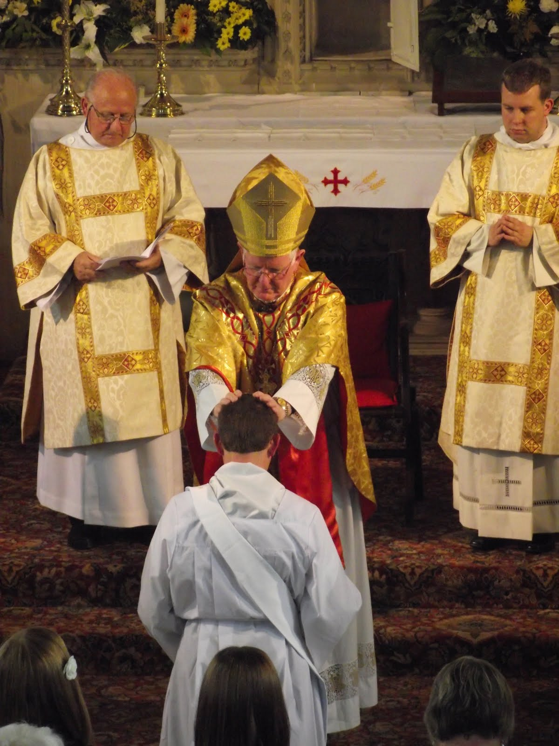
INSTITUTION
The way of ensuring that the Church will be maintained and its mission on Earth will continue.
Institutions are:
Organized patterns, rules, and social structures that have developed to help carry out a group or movement’s purposes

Slide 20
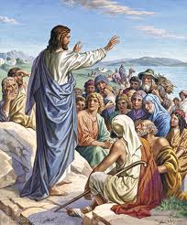
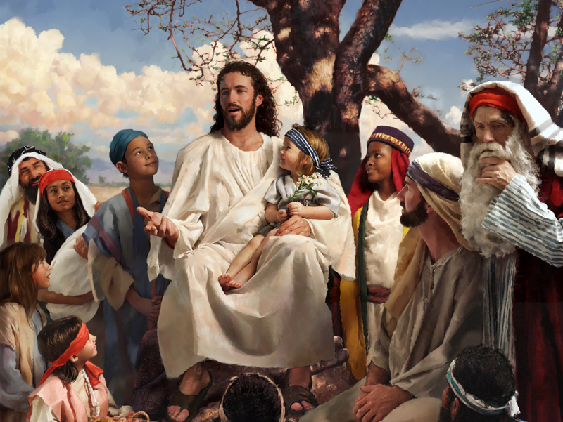
COMMUNITY OF DISCIPLES/ BODY OF CHRIST:
‘Disciple’ literally means ‘learner’
“Come, follow me,” Jesus said, “And I will make you fishers of men.”
  We are called to follow Jesus, to learn from him, to be like him, and to help others do the same.
  “I am the way, and the truth, and the life.”

Slide 21
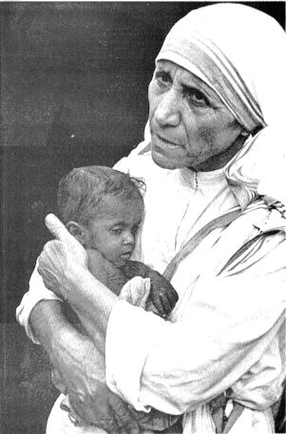
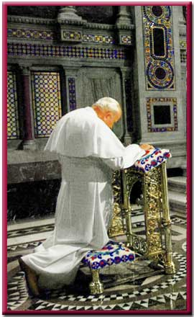
What Marks a Disciple?
A Heart for Christ Alone
A Mind Transformed
by the Word
3. Arms of Love
4. Knees for Prayer
5. A Voice to Speak the Good News
6. A Spirit of Servanthood & Stewardship

Slide 22
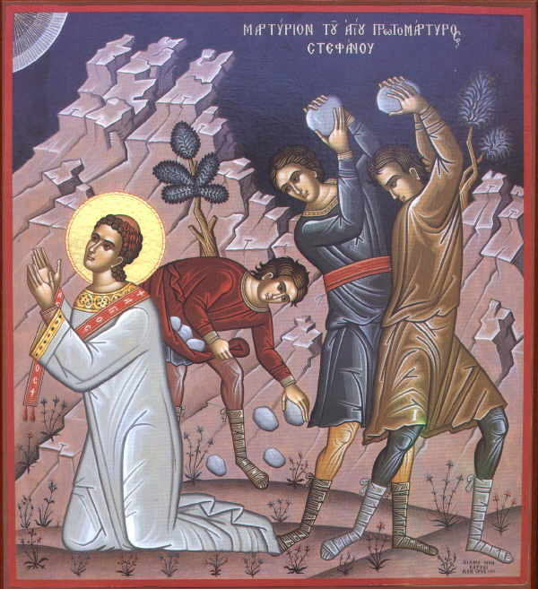
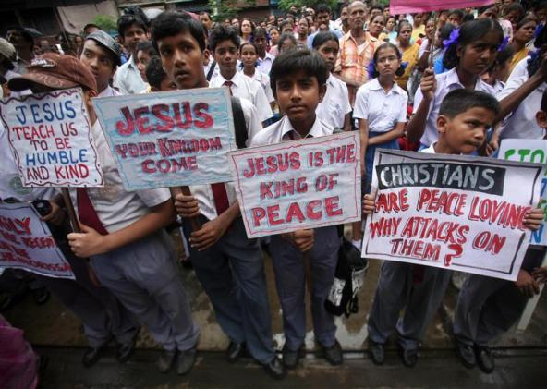
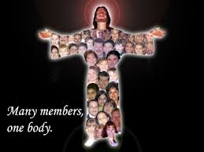
As the BODY OF CHRIST…
The community of disciples often stand in contrast with the rest of society (for example: less material success, social ridicule, persecution)
Christians are faithful, hopeful, loving people who often need to choose to be different.
We all have a unique role to play in the Church

Slide 23
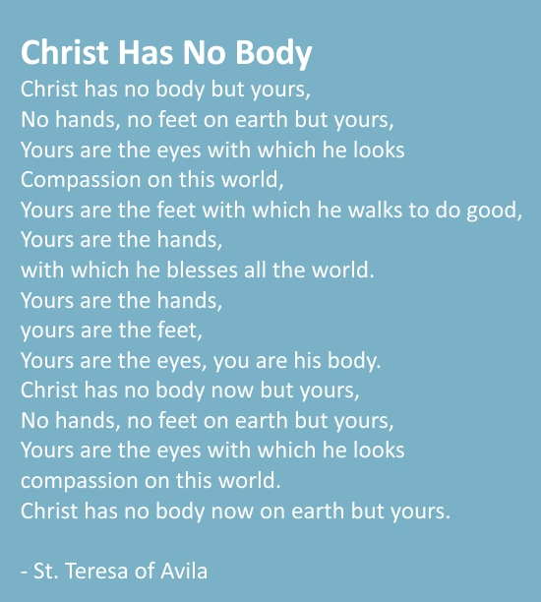
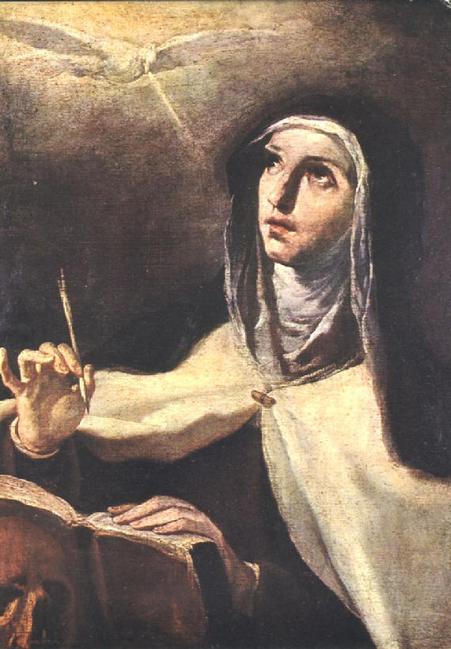
St. Teresa of Avila reminds us…
Christ has no body now but yours,
No hands, no feet on earth but yours.
Yours are the eyes with which he looks
Compassion on this world.
Yours are the feet with which he walks to do good.
Yours are the hands through which he blesses all the world.
Yours are the hands, yours are the feet,
Yours are the eyes, you are his body.
Christ has no body now on earth but yours.

Slide 24
How the models work together
The Church as Sacrament: founded by Christ, combining visible (human) with invisible (divine) dimensions that help us to grow in holiness. This leads to…
The Church as Community: Strengthened and called together by the sacraments, a community is created. This leads to . . .

Slide 25
How the models work together
The Church as Herald: The community feels compelled to share the good news with others. Which leads to . . .
The Church as Institution: A need to codify the beliefs of the community, so that the essential parts of the message are preserved. Which leads to . . .

Slide 26
How the models work together
The Church as Servant: A community of believers compelled to put their beliefs into action. Which leads to . . .
The Church as the Body of Christ: Founded by Jesus, this Church strives to imitate more and more clearly the life of its founder.

Slide 27

How the models work together
These models are best understood as a spiral, leading us deeper and deeper into the mystery of Christ.

