Slide 1
Media Literacy
“medium”

Slide 2
Mindfulness
Media mindfulness can be employed to focus on any medium and its productions.

Slide 3
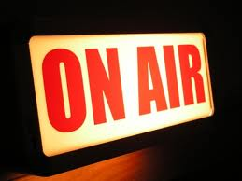
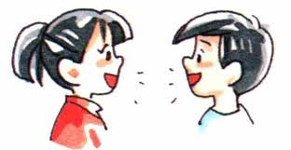
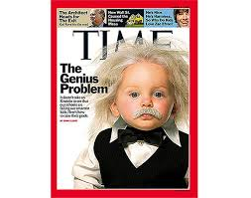
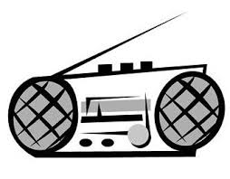
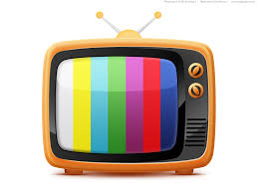
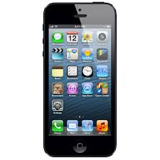
Communication
From the Latin communicare, meaning “to participate, share, or hold in common.”
To communicate means to impart information or tell a story, and it can take several forms.

Slide 4
MEDIA
Delivery systems
Deliver their content one-way.
A single source, such as a television station or network, transmits to millions of sets at one time.
Often called “mass communications.”
EFFECT??????

Slide 5
Culture
Culture . . . is a specific dimension of the existence and being of man. It creates among the persons within each community a complex of bonds, determining the interpersonal and social character of human existence. Man is both subject and creator of culture in which he expresses himself and finds his equilibrium.
(May 24, 1984, Message of the Holy Father for the XVIII World Communications Day, 2)

Slide 6
Values Inform Communication
Values are those overarching ideals and ideas that guide our lives.
We communicate about what is important to us.
It is important to be aware of the values presented or assumed by the media, as well as the values we bring.

Slide 7
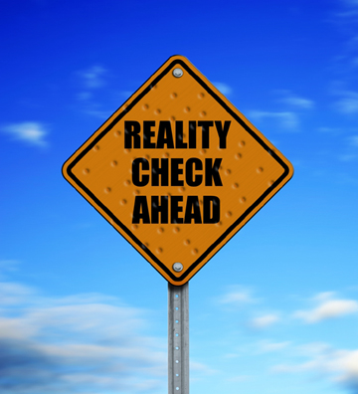
Are you media literate?
The media literate person is aware of the boundaries between true reality and the (possibly) constructed reality of the media and knows how to navigate them in meaningful ways.

Slide 8
Values Inform Communication
Authentic values are those of the Gospel that foster human dignity and the common good.
Self-centered values are contrary to Gospel values, and they lead to negative attitudes and behaviors that cause people to suffer both spiritually and materially.
For example: What is Beauty?

Slide 9
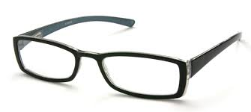
All of creation can reveal God to us…
Perspective:
Mindful Viewers/Readers:
Using these lenses, believers can deepen their faith life in a media-saturated world in ways that are both faithful & relevant to twenty-first century living.
see the world as a place full of wonder & awe
see the media as a potential place to discover the presence of God in all manner of places
KEY: Use eyes of faith to stay rooted in the values of the Gospel
WHY?: to live the spiritual values of Jesus in everyday life & find meaning.
Question & discern
See each medium in the context of its own structure and language

Slide 10
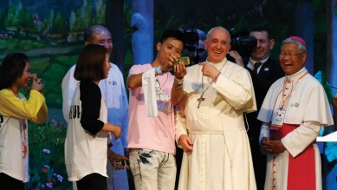
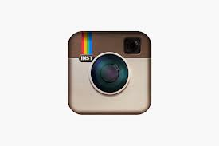
What does this mean for the Church???
A call to:
Use mass media to spread the Gospel
Integrate the message of salvation into the “new culture”
WHY??
Because these powerful means of communication affect us and our culture
HOW????

Slide 11
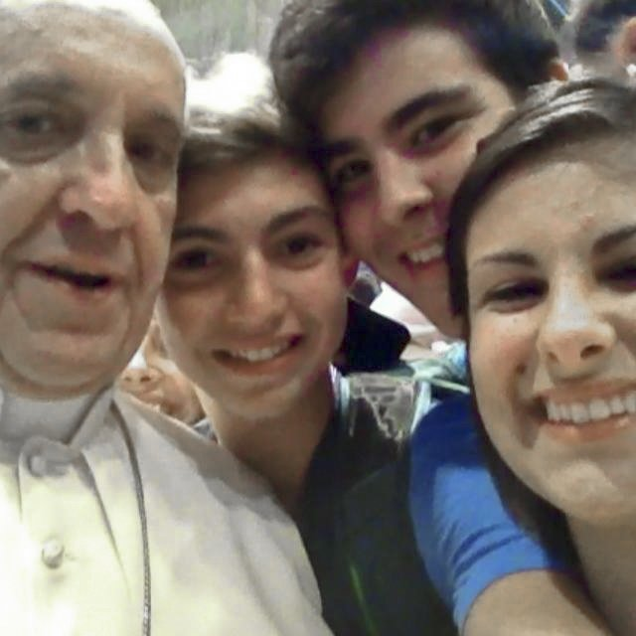
CHURCH’S RESPONSE
Use of the means of communication for:
religious information/ education
evangelization
formation of pastoral workers
Education to a mature responsibility of the users and the recipients of the various communications media

Slide 12
Extra Links:
Particularly regarding TV/video news coverage
Fr. Barron on his social media presence
Dove Real Beauty Sketches

