Slide 1
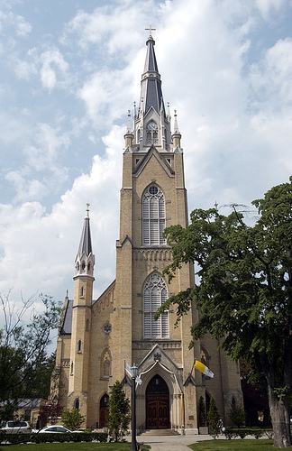
Marks of the Church

Slide 2
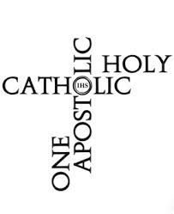
The Marks of the Church
One, Holy, Catholic, & Apostolic
Specific characteristics that date back to early Christianity.
In 381, at the first Council of Constantinople, the words “one, holy, catholic, and apostolic church” were officially added to the Nicene creed.

Slide 3
The Church is One
The highest exemplar is the unity of the Trinity-- Three Persons in one God
We are one because of our founder, Jesus Christ, who came to restore unity among all people & between all people and God.
Emphasized in the final prayer of Jesus before His Passion (John)

Slide 4
John 17:17-26
“Consecrate them in the truth. Your word is truth. As you sent me into the world, so I have sent them into the world. And I consecrate myself for them, so that they also may be consecrated in truth.
I pray not only for them, but also for those who will believe in me through their word, so that they may all be one, as you, Father, are in me and I in you, that they also may be in us, that the world may believe that you sent me. And I have given them the glory you gave me, so that they may be one, as we are one, I in them and you in me, that they may be brought to perfection as one, that the world may know that you sent me, and that you loved them even as you loved me. Father, they are your gift to me. I wish that where I am they also may be with me, that they may see my glory that you gave me, because you loved me before the foundation of the world. Righteous Father, the world also does not know you, but I know you, and they know that you sent me. I made known to them your name and I will make it known that the love with which you loved me may be in them, and I in them."

Slide 5
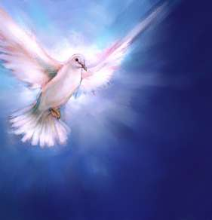
We are united in our Belief,
Worship, and Authority.

Slide 6
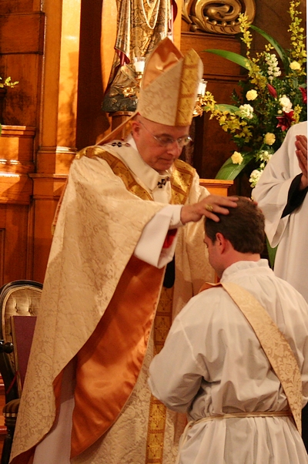
Formal Structures Help Maintain the Unity of the Church
Profession of one faith (received from the Apostles)
Common celebration of divine worship (especially the Sacraments)
Apostolic succession (through the Sacrament of Holy Orders)

Slide 7
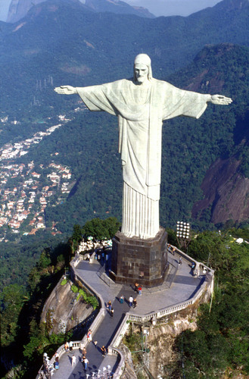
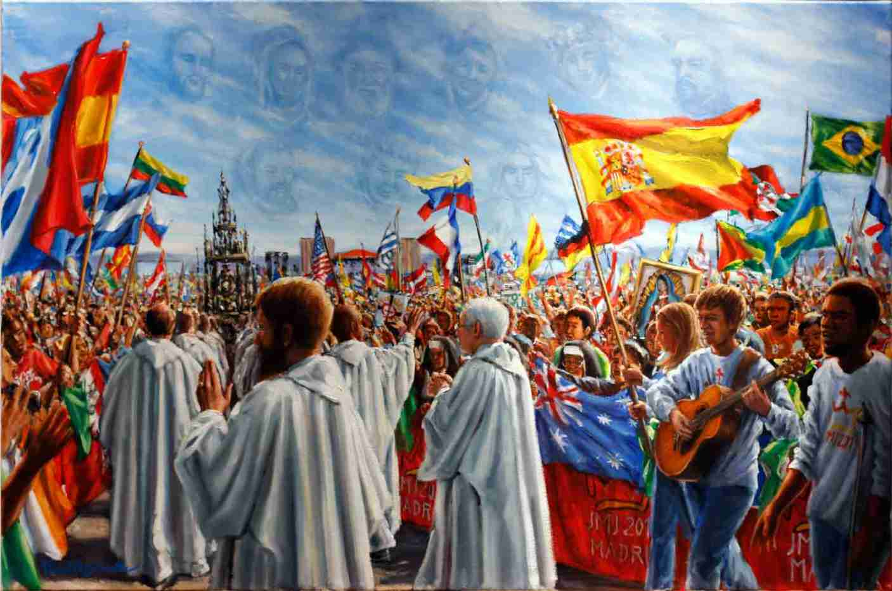
Unity ≠ Uniformity
Within the unity of the Church a multiplicity of people and cultures is gathered together.

Slide 8
The Church is Holy
The Church is the Body of Christ, The Holy One of God
Christ has united Himself to her, his Bride
The Holy Spirit dwells within her
God’s grace makes holiness possible for us

Slide 9
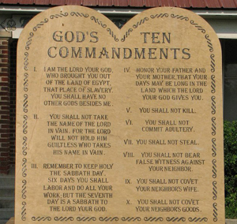
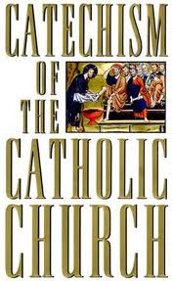
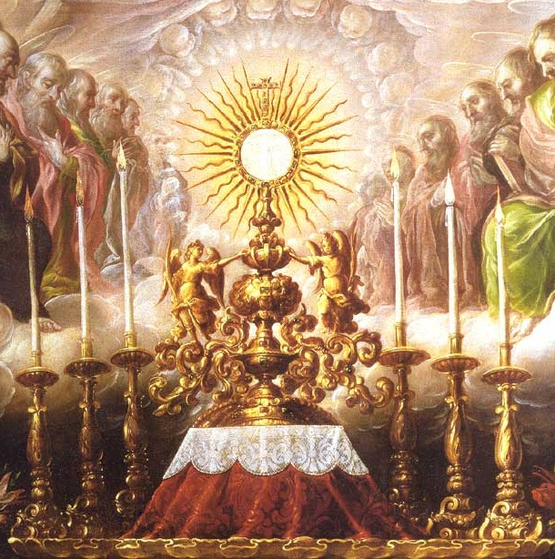
Two Ways the Church Supports Holiness
1) Moral Teachings of the Church
2) Sacraments

Slide 10
The Church is Catholic
This means:
*Universal
In totality
In keeping with the whole

Slide 11
The Church is Catholic
The Church is for all people.
Therefore, we must be a “missionary” Church.
Jesus said to spread His message “to the ends of the earth” (Acts 1:8). We can’t do that without being a missionary Church.

Slide 12
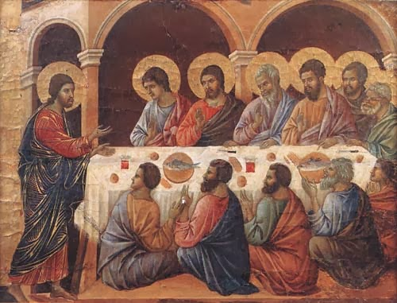
The Church is Apostolic
Apostolic means “having been sent”
The Church has been sent into the world by Christ

Slide 13
Apostolic Nature of the Church
1. Built upon the foundation of Apostles appointed by Jesus.
-The Church hands on the teachings of the Apostles
2. One can trace the Church’s authority back to that of the Apostles.

Slide 14
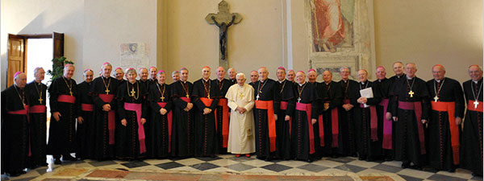
Apostolic Nature of the Church
The Church accepts the continued guidance of the Apostles through their successors:
The Pope and the Bishops

Slide 15
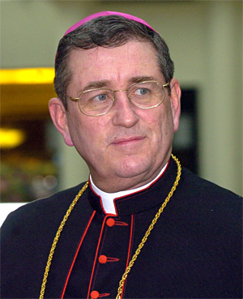
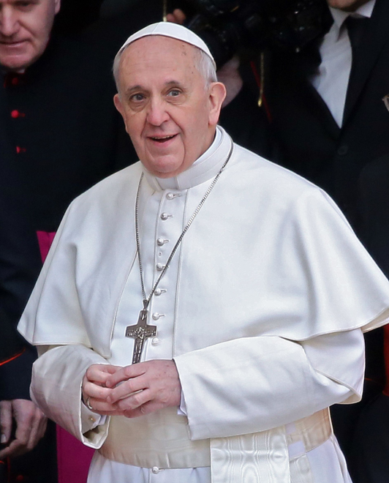
Apostolic Succession Today
As successors of the Apostles, the Bishops (in union with Pope) are able to guarantee that the teachings of the Church will be the teachings of Christ.
How? Infallibility – A gift given to the Church to protect her from teaching error.
Infallibility only pertains to official pronouncements on matters of faith and morals
Who exercises this gift? The Pope and the Bishops (in union with the Pope).

Slide 16
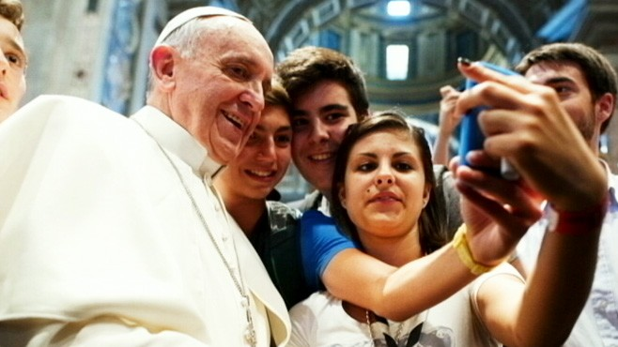
Pope: Source and Sign of Unity
Without the Pope, the unity of the Church would be severely threatened by local churches and bishops addressing competing national and cultural issues

Slide 17
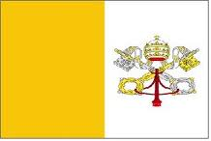
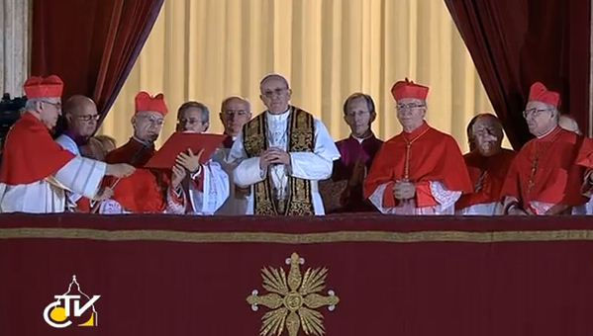
Role of the Pope
Bishop of Rome
The voice for the universal mission and vocation of the Church.
Calls Catholics everywhere to remember their responsibility to God and to all of God’s people.

