Slide 1
New Testament Images of Church
The Church Course
Document # TX001503

Slide 2
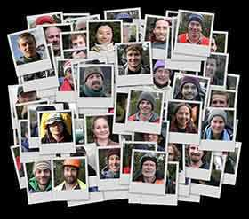
People of God
This image is rooted in the Old Testament covenants, where God accompanies and loves the Israelites.
The New Covenant, sealed in the Lord’s blood, invites all people everywhere to unite.
God calls the Church into existence, forming a community of faith, hope, and love centered in Christ and empowered by the Holy Spirit.
©mikeandaviva.blogspot.com

Slide 3
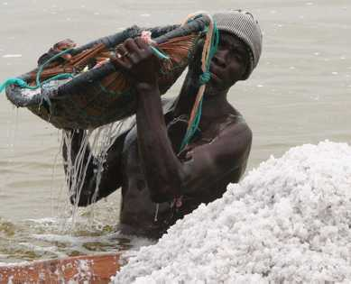
Salt
Of all the spices, may be the most necessary (every body must have salt) and the tastiest.
On its own, salt has a strong bite, but when mixed with other foods, it enhances the other flavors in the food.
Image in public domain

Slide 4
Salt
Jesus calls us to bring out the true flavor and goodness of the world, not only in ourselves but also in others.
Image in public domain

Slide 5
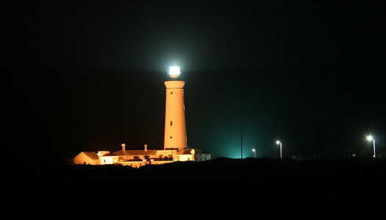
Light
Jesus told us that we each have talents and gifts to share with others and that we should not hide them or keep them to ourselves.)
Image in public domain
Notes:
(Notes: In this way,

Slide 6
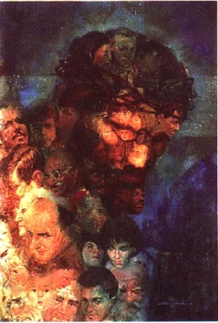
The Body of Christ
The Risen Christ formed his followers into his “Mystical Body”
Christ is the Head
The Holy Spirit is the Soul and bond of unity
We are the members

Slide 7
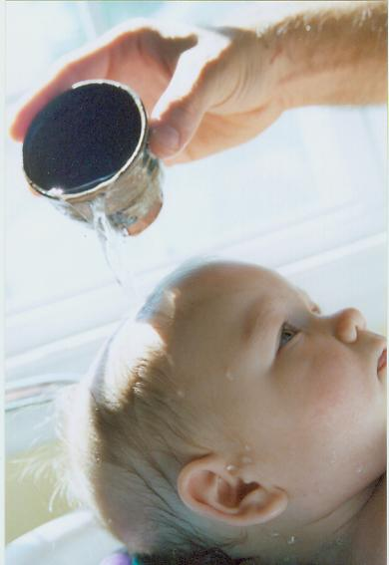
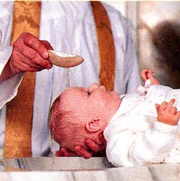
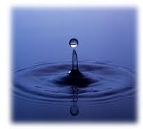
The Body of Christ
Baptism makes us a living cell in the body of Christ.

Slide 8
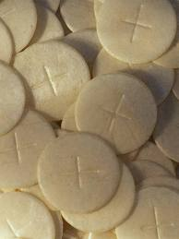
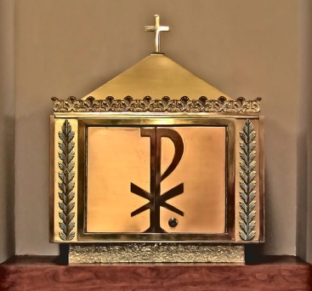
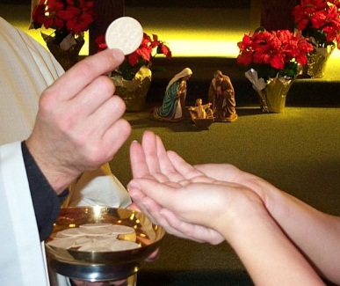
The Body of Christ
The Eucharist nourishes and strengthens the life of the Body of Christ by uniting us to Christ and to one another.
When we receive Holy Communion, we become what we receive.
Responding Amen to the words Body of Christ indicate our acceptance of Christ and the other members of his body in faith and love.

Slide 9
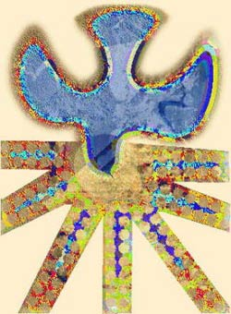
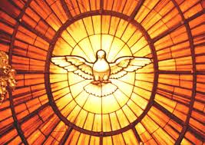
The Body of Christ
In the Body of Christ, there is a great variety of members and functions, empowered by the one Spirit of Jesus.
The Spirit gives different gifts for different ministries. (I Cor. 12)

Slide 10
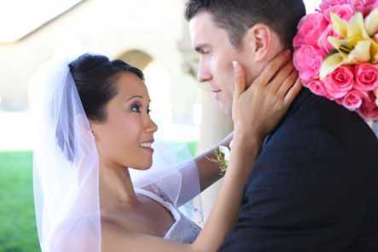
Bride of Christ
The Church is the Bride (promised & given) to:
Christ is the Groom, to whom the Church is promised and given.
This metaphor speaks of Christ’s great love for the Church.
©Shutterstock/Stehen Coburn

Slide 11
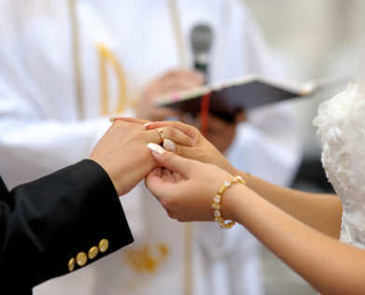
Bride of Christ (continued)
Their unity reveals
the intimate relationship God intends for husband & wife,
Christ & Church = 2 becoming 1 flesh.
©Shutterstock/MNStudio
Notes:
(Notes: 2 Corinthians 11:2; Ephesians 5:25–27; Revelation 19:7–9, 21:1–2)

Slide 12
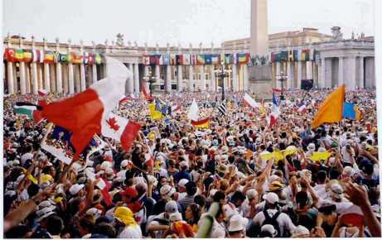
Temple of the Holy Spirit
The Old Testament temple = people (today) in whom the Spirit dwells
Image in public domain
Notes:
(Notes: 1 Corinthians 3:11,16; Ephesians 2:20–22; 1 Peter 2:4–8)

Slide 13
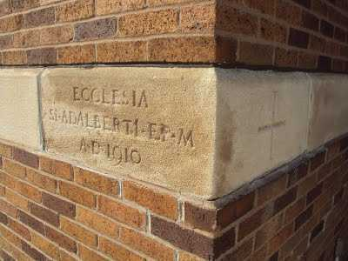
Temple of the Holy Spirit (continued)
Peter refers to Christians as “living stones.”
The structure of the temple of the Holy Spirit depends on Jesus Christ as the “cornerstone” for its coherence and stability.
©orbiscatholicussecundus.blogspot.com

Slide 14
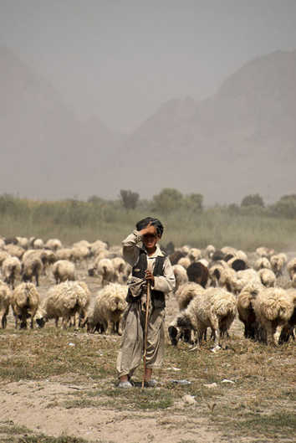
Christ’s Flock
Jesus = the Good Shepherd, knows
watches over his sheep
gives his life for them
they know his voice and follow him.
Image in public domain
Notes:
(Notes: John 10:11, Hebrews 13:20, 1 Peter 5:4, Luke 12:32)

Slide 15
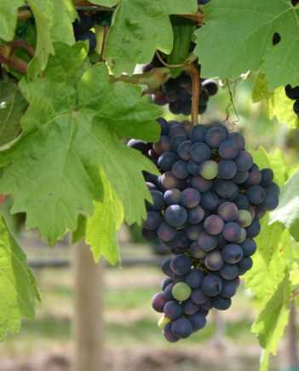
Vine and Vineyard
Jesus uses the metaphor of the vine and the branches to describe the intimate relationship he has with his disciples.
Image in public domain

Slide 16
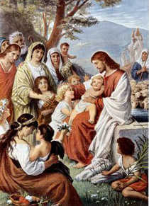
Family
We become children of God (Father)
through faith in Jesus Christ, the Son
by receiving the Holy Spirit.
Baptism = symbol of our adoption into the family of God.
Jesus = our elder brother.
Image in public domain
Notes:
(Notes: Galatians 3:26, 4:6–7; Romans 8:29; Hebrews 2:10–18)

Slide 17
Common Theme
The common theme of these images of the Church is relationships:
God’s relationship with his People
as Husband, King, Father, Builder
People of God’s relationship with God as Bride, Flock, Family, Body
Our relationship with one another as branches of the same vine, sheep in the same flock, children in the same family, members of the same body

