Slide 1
PREREQUISITES
&
PURPOSES of
PRAYER

Slide 2
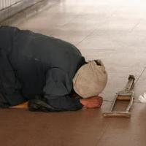
Prerequisites of Prayer
1. HUMILITY:
Foundation of Prayer
We are beggars before God
  EMPTY HANDS allow God a place to put his gifts

Slide 3
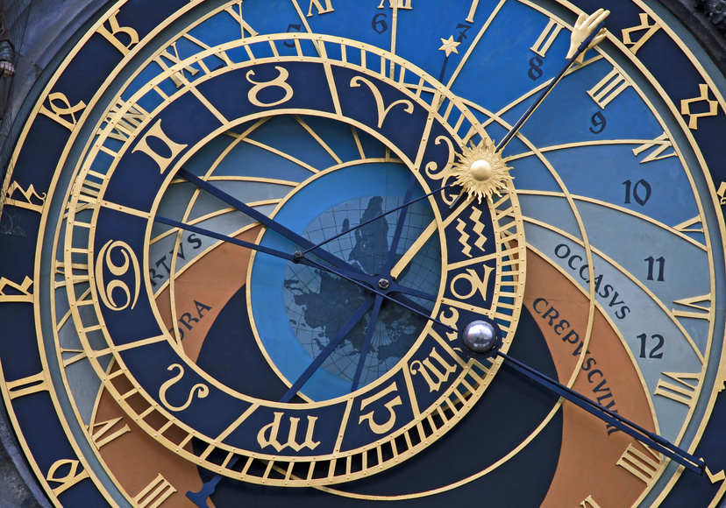
2.
Love: the source of prayer
Gives us an attitude of :
  TRUST & OBEDIENCE in relationships
  Shown by SACRIFICE = surest test of love
    Prayer: sacrifice of time: sure test of love for the other

Slide 4
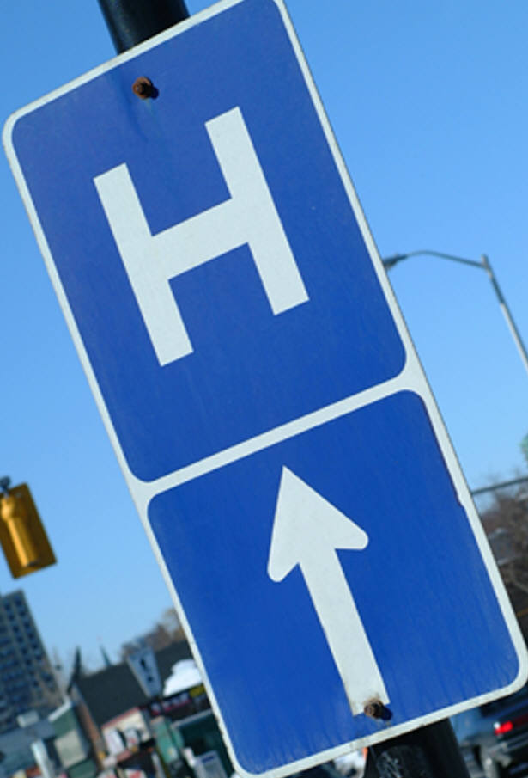
3.
FAITH & HOPE
FAITH: in Christ
HOPE: in Heaven
We ask in Jesus’ name because He is the WAY:
  His death has given us the ability to enter God’s presence

Slide 5

FIVE PURPOSES of PRAYER
A TRIP:
A = Adoration
T = Thanksgiving
R = Repentance
I = Intercessions
P = Petitions

Slide 6
ADORATION
Prayer of Praise
ADORATION through SCRIPTURE:
The Word of God

Slide 7
HUMILITY →AMAZEMENT
We are creature, God is creator
Humility allows us to trust that God hears the prayers of our hearts
This is an AMAZING blessing; we stand in AWE
AMAZED

Slide 8

PRAISE:
Our response of FAITH
We show how we love God before seeing him in glory

Slide 9
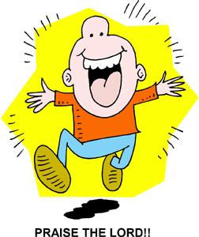
James 1:17:
“Every generous act of giving, with every perfect gift, is from above, coming down from the Father of lights, with whom there is no variation or shadow due to change.”
Adoration stems from FAITH
  Faith hopes and gives praise to the Father from whom every perfect gift comes down
  FAITH is pure PRAISE…..

Slide 10
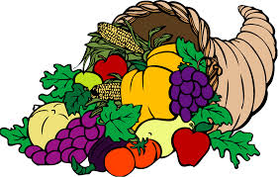
Thanksgiving
Matthew 11: 25-27; John 11: 41-42
It is healing to our spirits to count our blessings and thank God for everything that is good.
Everyone’s blessing list should always include at least 4 things:
  Life itself, our existence, salvation from sin (the hope of Heaven), God’s existence and his daily grace
1 Thessalonians 5:18: “Give thanks in all circumstances; for this is the will of God in Christ Jesus for you.”

Slide 11

REPENTANCE
Asking FORGIVENESS=
Prerequisite for
MASS
&
personal prayer
WHY?

Slide 12
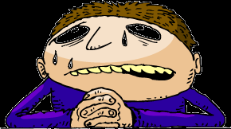
REPENTANCE
An expression of our relationship with God
  We are sinners who have turned away from our Father
Examine our conscience & confess our sins privately AND sacramentally
Admission of Reality: In comparison we may seem OK, but in the presence of the all-holy God:
  Honesty compels repentance
  Turn our hearts from self-centeredness

Slide 13
INTERCESSION
Asking on behalf of another
Characteristic of a heart attuned to God’s mercy
  GOOD IDEA: keep a prayer list of people to intercede for daily as well as praying for them.
  SAINTS: the great cloud of witnesses (Heb 12:1) who surround us: their love remains…to intercede for us to God

Slide 14

PETITION
Ask God for the things YOU need
  He sees what we need most
  He desires to be in relationship with us

Slide 15

Romans 15:13:
“May the God of hope fill you with all JOY and PEACE in believing, that you may abound in hope and in the power of the Holy Spirit.”

