Slide 1
Article 25
The Events of the Resurrection

Slide 2
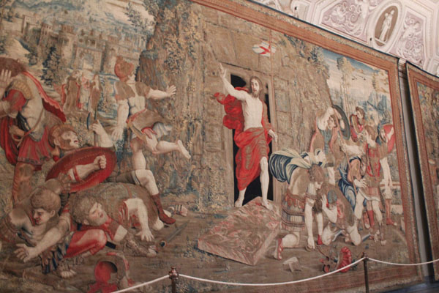
The Resurrection
The heart of the Paschal Mystery
Close connection to the Incarnation (analogy of faith)

Slide 3
What actually happened?
The Gospel accounts have this in common:
First some women, then men, discover the empty tomb.
It is revealed that Jesus is alive.
Jesus appears to Mary Magdalene (women).
Jesus appears to other disciples.
Reactions: Shock and fear
Wishes them peace and instructs them to continue his mission
There are also many differing details, but…

Slide 4
We know the resurrection is true
We can trust the historical validity of the New Testament books
Accepted as fact by Christians from the beginning
Romans, Sanhedrin, and the empty tomb
Caused a profound change in Jesus’ followers
Gave them courage
They acted with total conviction; no more fear

Slide 5
Article 26
What is the Resurrection?

Slide 6
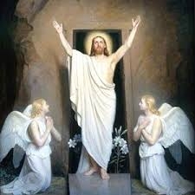
The resurrected Jesus
Not easy to explain in human terms
Comes and goes suddenly
Not a ghost
Eats
Able to be touched
Different, yet the same
Resurrection of the body is a mystery of our faith

Slide 7
1 Corinthians 15
O death, where is your victory?
O death, where is your sting? (15:55)
Combatting gnosticism
Main Points:
The Resurrection really happened!
Christ’s Resurrection is proof of our resurrection
A resurrected body is a transformed body (incorruptible, honorable, powerful, spiritual)

Slide 8
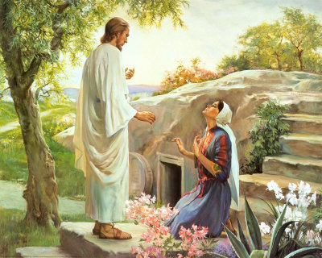
Christ is Risen
Put yourself in the shoes of the early disciples. How do you respond to the Resurrection? How is your life affected or changed by this reality?

Slide 9
Article 27
The Significance of Christ’s Resurrection

Slide 10
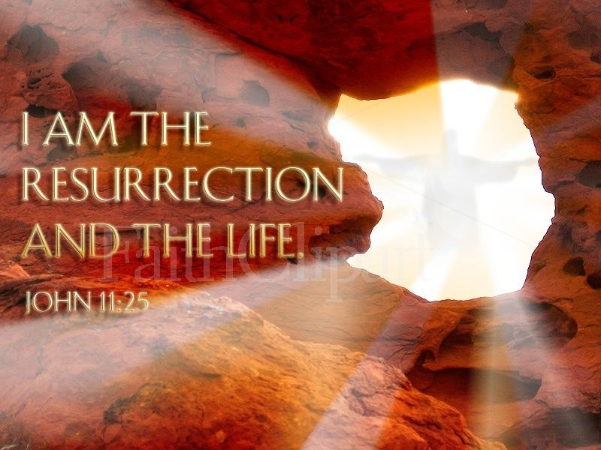
The resurrection confirms revealed truths
Jesus is the Son of God
“When you lift up the Son of Man, you will realize that I AM.” (John 8:28)
“My LORD and my God!” (John 20:28)
Belief in the Resurrection and Incarnation go hand in hand
All of Jesus’ teachings are true

Slide 11
The Resurrection opens the way to new life
The Paschal Mystery has two aspects: by his death, Christ liberates us from sin; by his Resurrection, he opens for us the way to new life. This new life is above all a justification that reinstates us in God’s grace, “so that as Christ was raised from the dead by the glory of the Father, we too might walk in the newness of life.”
(CCC 654)

