Slide 1
The Ascension
Article 28

Slide 2
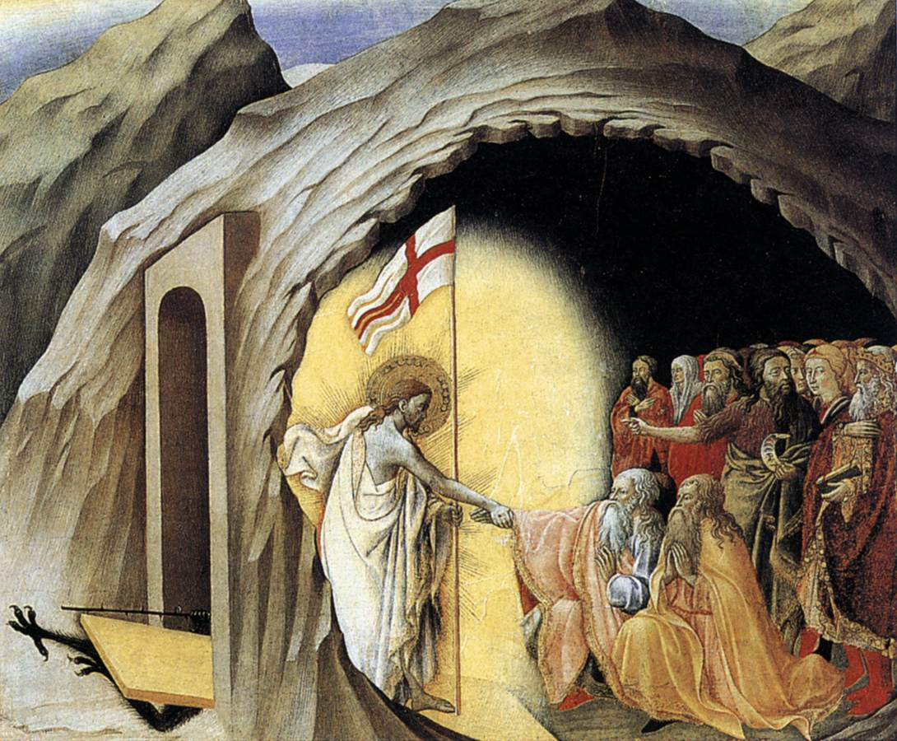
Back up: What happened after Jesus died and before he rose?
Christ’s Descent into Hell
Jesus experienced the complete loss of life that comes with death
Jesus then descended to the realm of the dead; “Hell”
Righteous brought to Heaven
Unrighteous remain in Hell

Slide 3
Then Jesus rose from the dead…
Recap:
Glorified Body
On earth for 40 days
Appears to many, continues teaching
Directs disciples to continue his mission
After 40 days, Jesus ascends into heaven

Slide 4
The Ascension
“He ascended into Heaven and is seated at the right hand of the Father.” (Nicene Creed)
“So then the LORD Jesus, after he spoke to them, was taken up into Heaven and took his seat at the right hand of God.” (Mark 16:19)
“As he blessed them he parted from them and was taken up to Heaven.” (Luke 24:51)
“And after he had said these things, he was lifted up while they were looking on, and a cloud received him out of their sight. And as they were gazing intently into the sky while he was going, behold, two men in white clothing stood beside them. They also said, ‘Men of Galilee, why do you stand looking into the sky? This Jesus, who has been taken up from you into heaven, will come in just the same way as you have watched Him go into Heaven.’” (Acts 1:9-11)

Slide 5
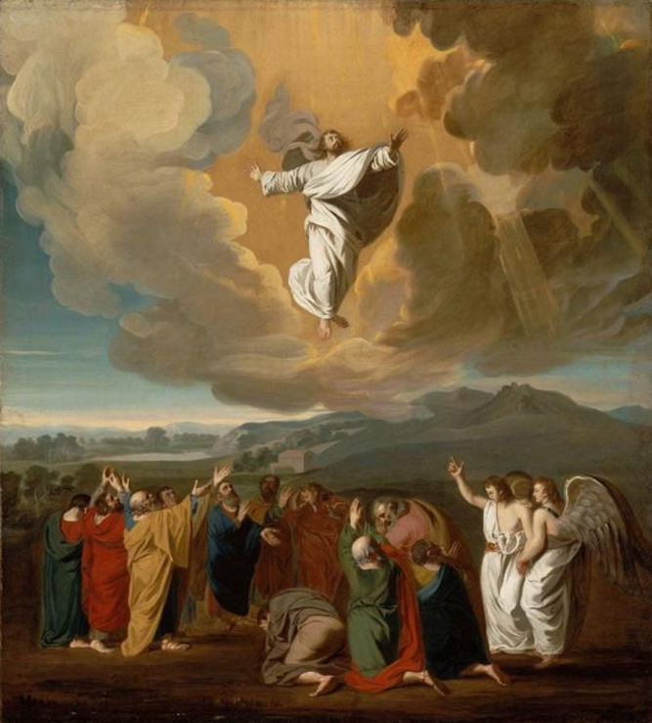
The Significance of Christ’s Ascension
Article 29

Slide 6
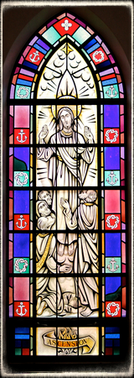
Celebration Today:
40 Days after Easter
Always on a Thursday (the date varies)
May be celebrated the following Sunday
Incarnation Ascension
Symmetry
Jesus remains true God and true man for the rest of eternity

Slide 7
3 Implications of This Mystery
Jesus has full authority and reign as God; free from the limits he humbly accepted on Earth
Doors of heaven open, and will remain so
Paradoxically, Jesus can be more present to us now
“Behold, I am with you always, until the end of the age.” (Matthew 28:20)
“I will ask the Father, and he will send you another Advocate to be with you always, the Spirit of Truth…I will not leave you orphans; I will come to you.” (John 14:16-18)

Slide 8
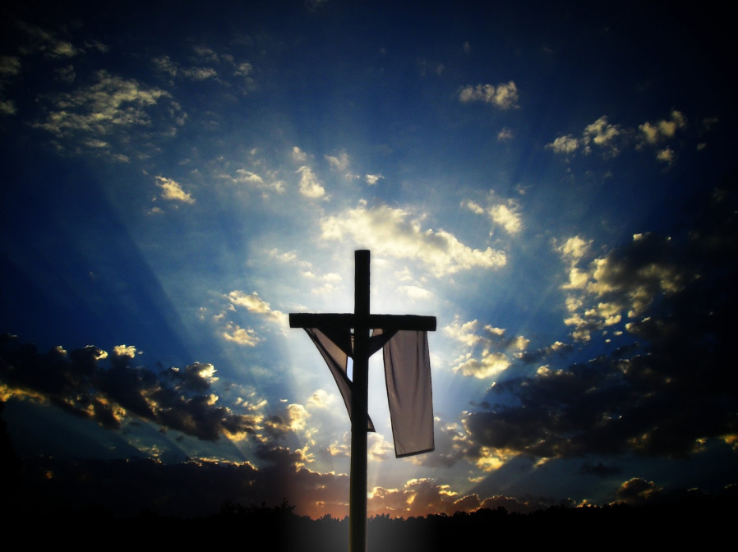
Jesus is Present to Us Now
In…
The Eucharist
The Scriptures
Prayer
Others
After his Ascension, Jesus is not limited as he was during his human life. He is everywhere, with everyone, for all time.

Slide 9
He left our sight so that we might return to our heart and find him there. He went away and look: here he is.
--St. Augustine

Slide 10
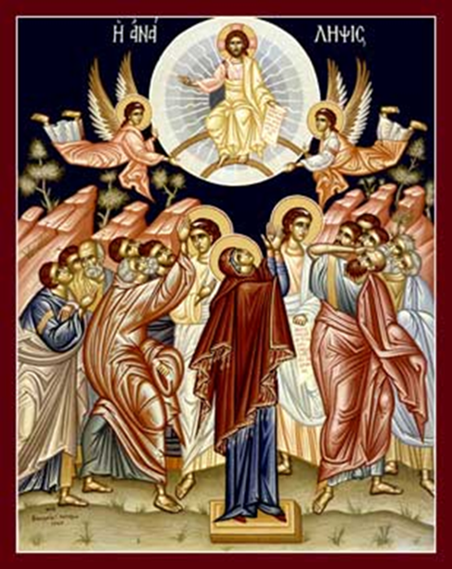
Gaze upon this icon of the Ascension. Let it speak to you.
How is Jesus’ location represented?
What might the positioning and activities of Mary and the Apostles represent?
What else stands out to you?

