Slide 1
Unit 4: God’s plan for salvation is fulfilled
The Suffering, Death, Resurrection, and Ascension of Jesus

Slide 2
Article 22
The Events of the Passion

Slide 3
The passion
The sufferings of Jesus during his final days in this life
His agony in the garden at Gethsemane
His trial
His Crucifixion
The Passion Timeline (pg. 96)
Passion- from the Greek πάσχω (pascho) “to suffer”

Slide 4
The Events Leading to Jesus’ death
Same basic account of these events in all four Gospels
Jesus enters Jerusalem
Quick change
The Last Supper
Eucharist, washing of feet
The Garden at Gethsemane
Betrayal/Acceptance; Obedience/Disobedience
The Trial before the Sanhedrin
Blasphemy—Capital Crime??
The Trial before Pilate
Treason—Was he threatened??

Slide 5
Continued…
The Scourging
Brutal
The Crucifixion
Golgotha/Calvary
Fulfilling Christological Prophecies
Last words show suffering, humanity, forgiveness, love, trust
Jesus’ Death
Within six hours
Dramatic natural events
Body taken down

Slide 6
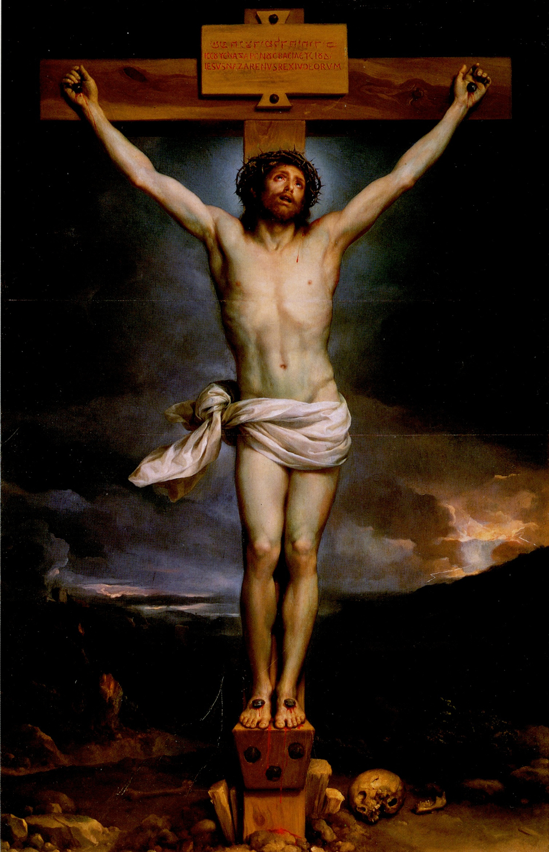

Slide 7
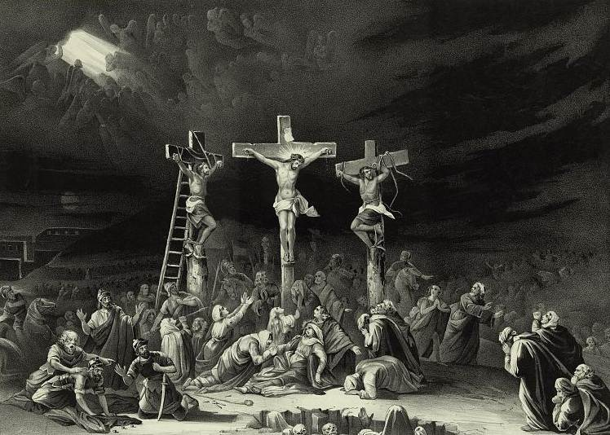

Slide 8
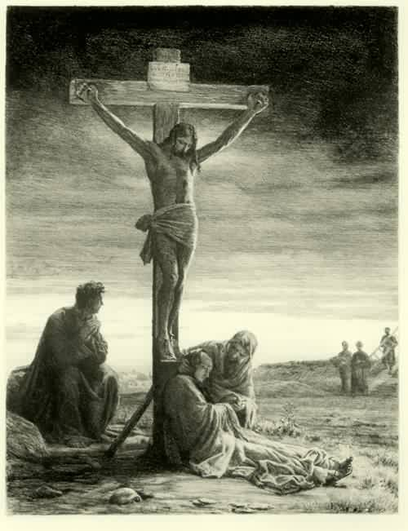

Slide 9
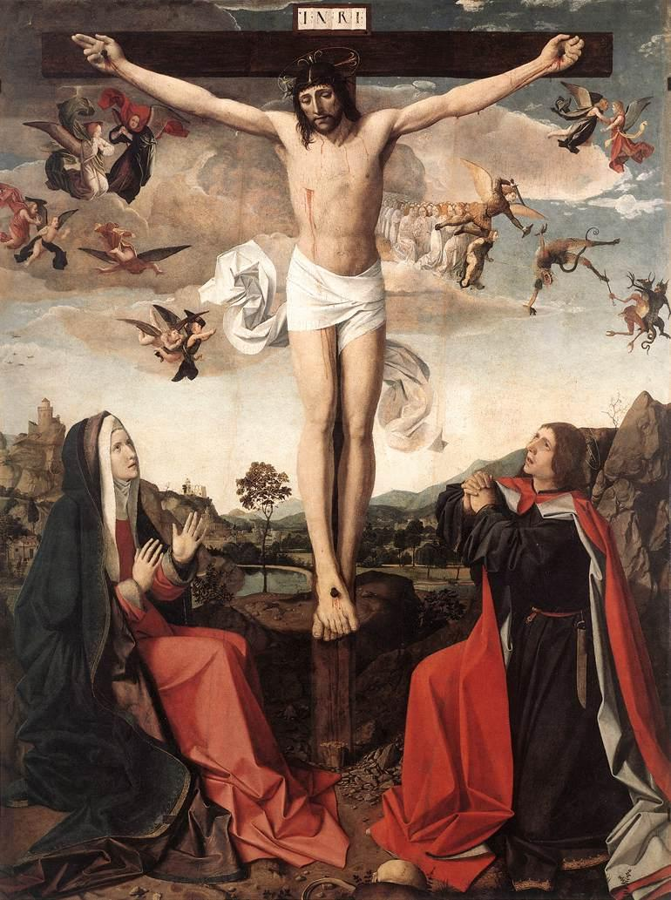

Slide 10
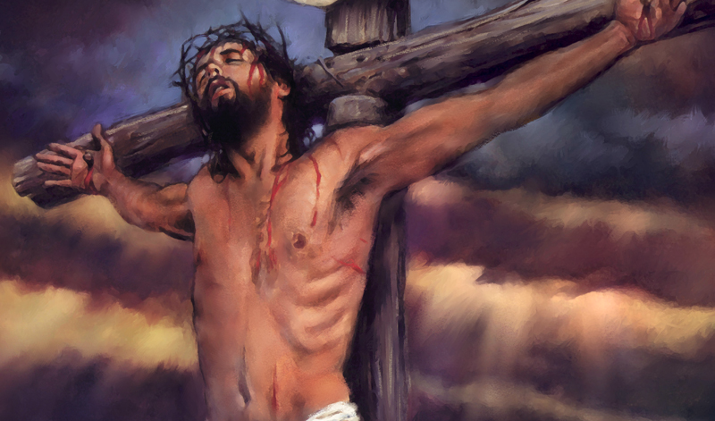

Slide 11
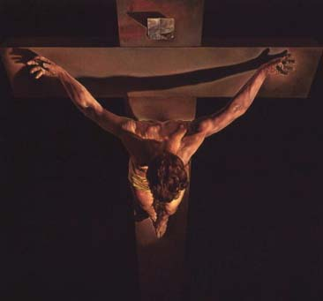

Slide 12
In your Journal…
Contemplating one of these images (or perhaps another that you have in mind), reflect for a few moments and write a prayer to the crucified Jesus, your suffering Savior.

Slide 13
Let us pray
Jesus,
You were obedient to your Father even though it meant that you would be abandoned by your friends, mocked by the authorities, accused of being a criminal, stripped and beaten, nailed to a cross, and executed. You remind me to do the right thing despite the difficulties I may endure. By putting all my faith in you, I know I can endure mockery, abandonment, rejection, or even worse.
Give me the strength to bear the crosses in my life. In my most difficult moments, remind me that the cross is not the end, but the beginning. Give me the courage to let go of greed, hatred, lust, pride, and everything else that keeps me from doing your will. Let them die, and let me be reborn in you. In my painful moments, remind me of St. Paul’s words: “The message of the cross is foolishness to those who are perishing, but to us who are being saved it is the power of God.”
Amen.

Slide 14
Article 23
Who Killed Jesus?

Slide 15
True God and True Man… divine and human reasons for Jesus’ death
Human Reasons: The Jewish Leaders and the Roman Leaders
Jewish Leaders’ Reasons
Challenged and undermined authority
Healed on the Sabbath
Forgave sins
Associated with and blessed the poor, sinners, unclean
Direct challenge in the Temple
Blasphemy

Slide 16
True God and True Man… divine and human reasons for Jesus’ death
Roman Leaders’ Reasons
Pontius Pilate- Roman Procurator
Main job: collect taxes and keep the peace
Did Pilate really want Jesus killed?
Mixed feelings
Amazed?
Innocent?
Options?
Bottom Line: Pilate had the final say

Slide 17
Overview: The Passion
Heart of the Christian faith
High point of Jesus’ saving work on earth
Everything leads to this
Salvation is accomplished!
Jesus’ faithfulness and obedience to God’s will out of love for us is a perfect example of redemptive love

Slide 18
John 15: 13
“No one has greater love than this, to lay down one’s life for one’s friends.”
Reflect on this verse from John and the reading of the Passion Narrative that we did today. How do you react and respond to this ultimate act of redemptive love from Jesus?

Slide 19
Article 24
The Meaning of the Cross

Slide 20
Divine reasons for Jesus’ Death
The Father planned that his Son would take on the burden of sin for all humanity
“By his wounds you have been healed.” (1 Peter 2:24)
Salvation for all people
How does Jesus’ death free us from sin???
3 metaphors of explanation:
The Suffering Servant
The Paschal Lamb
The Ransom for Many

Slide 21
Jesus, the Suffering Servant
Isaiah “suffering servant” passages
“He was pierced for our transgressions, crushed for our sins, upon him was the chastisement that makes us whole, by his stripes we were healed.” (53:5)

Slide 22
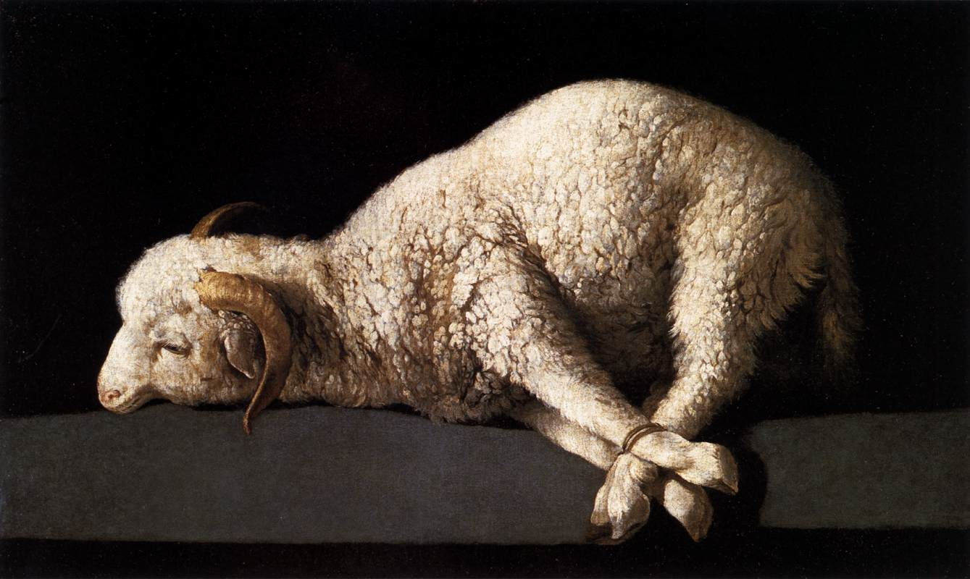
Jesus, The Paschal LAmb
Jesus is “the Lamb of God, who takes away the sin of the world.” (John 1:29)
Recall: The final plague before Pharaoh released the Israelites from slavery in Egypt

Slide 23
Jesus, the Ransom For Many
Ransom: a price paid to release a slave
Saving nature of Jesus’ death explained (particularly for Gentiles)
Jesus paid the price!
“For the Son of Man did not come to be served but to serve and to give his life as a ransom for many” (Mark 10:45).

