Slide 1
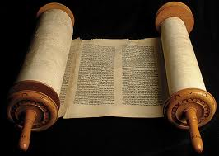
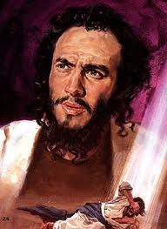
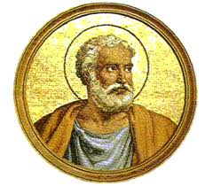
Acts of the Apostles
An Introduction

Slide 2
Why are we studying Acts?
To get in touch with our Christian roots and to be inspired by the faith and commitment of the early Christians
To have a better understanding of our present Church

Slide 3
What is the Acts of the Apostles?
A Biblical book containing a theological history of the first 30 years of Christianity.
A personal history of the early Christian community
A travel story recounting how and why Christianity moved from Jerusalem to Rome
A companion volume to the third Gospel
The Gospel of the Holy Spirit

Slide 4
Some Preliminary Comments
Author: Luke
Addressed to Theophilus
Sources Used: anecdotes, speeches, & personal recollections of the first Christians
Especially Peter & Paul
Time Period covered by Acts: ~33AD to 63AD
When Acts was written: ~85AD
Theme of Acts: The growth of the Church in numbers and in understanding its universal character
Leading Personalities: Peter and Paul

Slide 5
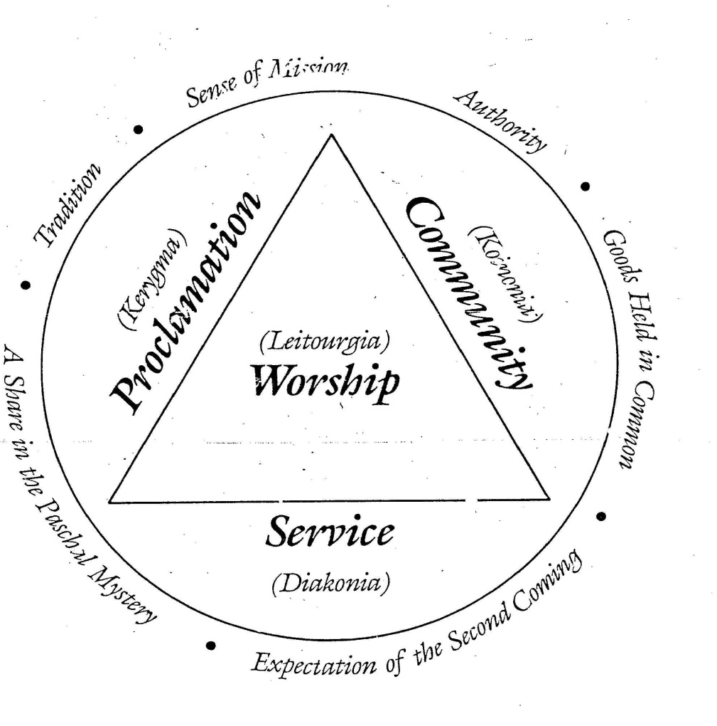
Patterns in the Early Church
KERYGMA
KOINONIA
DIAKONIA
LEITOURGIA

